Slide 1
Recapitulation of Chapter c
When two objects have the same temperature, they are in thermal equilibrium and there is no heat exchange between them.
The first law of thermodynamics is a statement of energy conservation that includes heat.
The internal energy of a system depends only on its temperature, pressure, and volume.
A quasi-static process is one in which the system may be considered to be in equilibrium at all times.

Slide 2
Summary of Chapter c
In a reversible process it is possible to return the system and its surroundings to their initial states.
Irreversible processes cannot be undone.
The work done during a process is equal to the area under the curve in the PV plot.
The work done at constant pressure is:
The work done at constant volume is zero.
The work done in an isothermal expansion is:

Slide 3
Summary of Chapter c
An adiabatic process is one where no heat transfer occurs.
The value of the specific heat depends on whether it is at constant pressure or at constant volume.
Molar specific heat is defined by:
For a monatomic gas at constant volume:

Slide 4
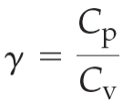
Summary of Chapter c
For a monatomic gas at constant pressure:
In an adiabatic process, is constant, where:
For a monatomic ideal gas:
The spontaneous flow of heat between objects in thermal equilibrium is always from the hotter one to the colder one: The 2nd law of thermodynamics.
A heat engine converts heat into work.

Slide 5
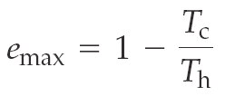
Maximum efficiency: $\frac{Q_{C}}{Q_{H}}=$ $\frac{T_{C}}{T_{H}}$
Efficiency of a heat engine:
A reversible engine has the maximum possible efficiency :
$\frac{Q_{C}}{Q_{H}}=$ $\frac{T_{C}}{T_{H}}$

Slide 6
Summary of Chapter c
The maximum possible work:

Slide 7
Example c.11

Slide 8
The heat engine below is
a reversible (Carnot) heat engine.
an irreversible heat engine.
a hoax.
none of the above.
Heat Engine
Notes:
Answer: B

Slide 9
The heat engine below is
a reversible (Carnot) heat engine.
an irreversible heat engine.
a hoax.
none of the above.
Carnot e = 1 − T_{C}/T_{H} = 1 − 270/600 = 0.55.
But by definition, e = 1 − Q_{L}/Q_{H}
= 1 − 4000/8000 = 0.5, smaller than Carnot e, thus irreversible.
Follow-up: What would you need to change to make it a Carnot engine?
Heat Engine

Slide 10
For the heat engine below, what is the value of W, and what would be the maximum W for the given Q_{H} with the given T_{H} and T_{C}?.
4000 J and 5000 J
5000 J and 4400 J
4000 J and 4400 J
None of the above
Heat Engine
Notes:
Answer: C

Slide 11
For the heat engine below, what is the value of W, and what would be the maximum W for the given Q_{H} with the given T_{H} and T_{C}?.
4000 J and 5000 J
5000 J and 4400 J
4000 J and 4400 J
None of the above
By energy conservation, W = Q_{H} – Q_{C} = 8000 J – 4000 J, which equals 4000 J. As indicated in the previous slide, e_{max}= 0.55, so by definition, the W_{max}= 0.55(8000 J) = 4400 J.
Heat Engine

Slide 12
c-7 Refrigerators, Air Conditioners, and Heat Pumps
While heat will flow spontaneously only from a higher temperature to a lower one, it can be made to flow the other way if work is done on the system. Refrigerators, air conditioners, and heat pumps all use work to transfer heat from a cold object to a hot object.

Slide 13
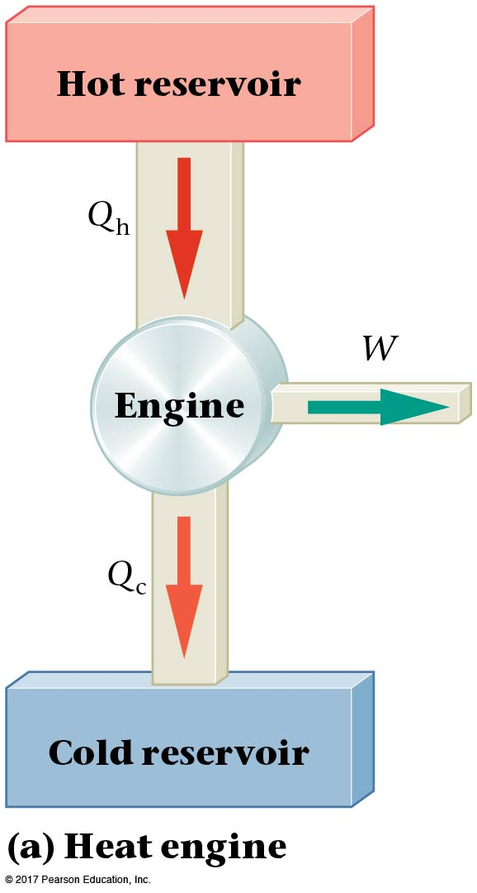
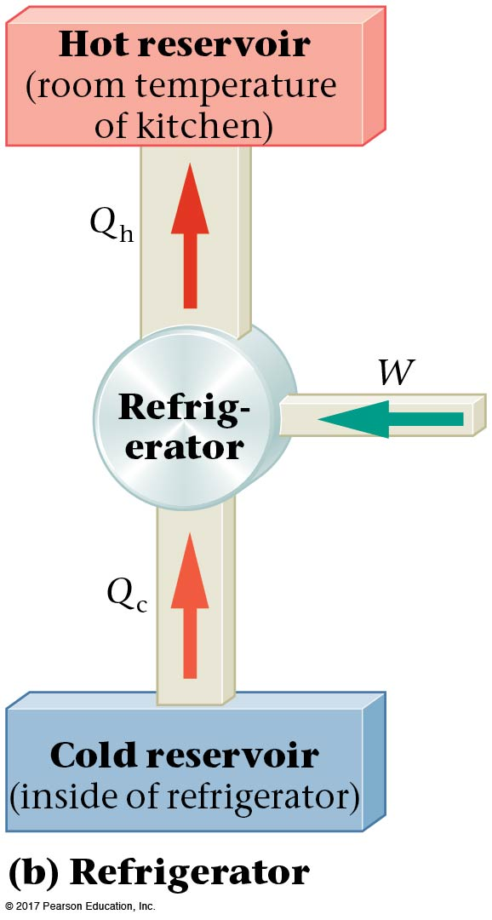
c-7 Refrigerators, Air Conditioners, and Heat Pumps
If we compare the heat engine and the refrigerator, we see that the refrigerator is basically a heat engine running backwards—it uses work to extract heat from the cold reservoir (the inside of the refrigerator) and exhausts to the kitchen. Note that —more heat is exhausted to the kitchen than is removed from the refrigerator.

Slide 14
c-7 Refrigerators, Air Conditioners, and Heat Pumps
An ideal refrigerator would remove the most heat from the interior while requiring the smallest amount of work. This ratio is called the coefficient of performance (COP):
Typical refrigerators have COP values between 2 and 6. Bigger is better!

Slide 15
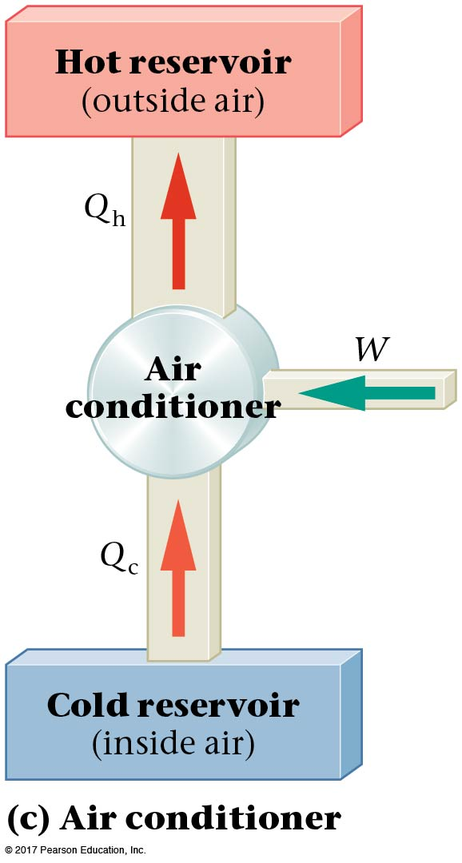
c-7 Refrigerators, Air Conditioners, and Heat Pumps
An air conditioner is essentially identical to a refrigerator; the cold reservoir is the interior of the house or other space being cooled, and the hot reservoir is outdoors. Exhausting an air conditioner within the house will result in the house becoming warmer, just as keeping the refrigerator door open will result in the kitchen becoming warmer.

Slide 16
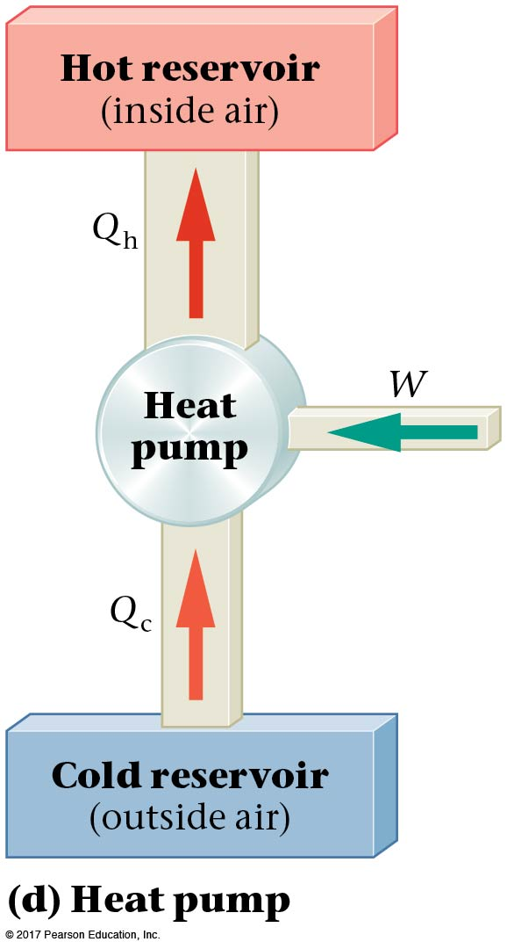
c-7 Refrigerators, Air Conditioners, and Heat Pumps
Finally, a heat pump is the same as an air conditioner, except with the reservoirs reversed. Heat is removed from the cold reservoir outside, and exhausted into the house, keeping it warm. Note that the work the pump does actually contributes to the desired result (a warmer house) in this case.

Slide 17
c-7 Refrigerators, Air Conditioners, and Heat Pumps
In an ideal heat pump with two operating temperatures (cold and hot), the Carnot relationship holds; the work needed to add heat Q_{h} to a room is:
The COP for a heat pump: (Not $Q_{c}$)

Slide 18
Example c.16

Slide 19
An air conditioner is designed to exhaust 2400 J per cycle to the outside air with a required work input of 500 J. What is the COP for this air conditioner?
5.80
4.80
3.80
Air Conditioner & Heat Pump
Notes:
Answer: C

Slide 20
An air conditioner is designed to exhaust 2400 J per cycle to the outside air with a required work input of 500 J. What is the COP for this air conditioner?
5.80
4.80
3.80
By energy conservation, Q_{C}= Q_{h} – W
= 2400 J – 500 J = 1900 J. By definition for an air conditioner, the COP is Q_{C}/W, which equals 1900 J/ 500 J = 3.80.
Air Conditioner & Heat Pump

Slide 21
The air conditioner is reversed and is used as a heat pump with the same values for W=500 J and Q_{H} =2400J. For this heat pump, what is the COP?
5.80
4.80
3.80
Air Conditioner & Heat Pump
Notes:
Answer: B

Slide 22
The air conditioner is reversed and is used as a heat pump with the same values for W and Q_{H}. For this heat pump, what is the COP?
5.80
4.80
3.80
By definition for a heat pump, the COP is Q_{h}/W = 2400 J/ 500 J = 4.80. Note this is one more than the COP for the air conditioner.
Air Conditioner & Heat Pump

Slide 23
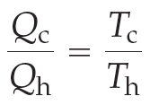
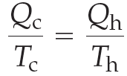
c-8 Entropy $\frac{Q_{}}{T_{}}=∆S$
A reversible engine has the following relation between the heat transferred and the reservoir temperatures:
Rewriting:
This quantity, Q/T, is the same for both reservoirs, and is defined as the change in entropy .

Slide 24
c-8 Entropy $\frac{dQ_{}}{T_{}}=dS$
$∆S=Q/T$
Heat Q is a random energy, since kT is of dimension energy, the entropy is a dimensionless measure of the randomness of the system.
For this definition to be valid, the heat transfer must be reversible.
In a reversible heat engine, the entropy does not change.

Slide 25
Entropy S is ln(no of configurations)
The two system that are in thermal contact achieve an equilibrium states that is the most likely and maximize the total number of configurations.
We define a quantity S so that $e^{S{(E}_{})}=\int{dyδ[E_{B}\left(y\right)−E]}$ is the total number of configurations for a system with energy E .
${1/(k}_{B}T)=\frac{dS{(E}_{})}{dE}$
dW=0 for systems only in thermal contact and no change in volume. So only the energy transferred is the heat. Because dV=0, dE=dQ=kTdS

Slide 26
c-8 Entropy
A real engine will operate at a lower efficiency than a reversible engine; this means that less heat is converted to work. Therefore:
Any irreversible process results in an increase of entropy.

Slide 27
c-8 Entropy
To generalize:
The total entropy of the universe increases whenever an irreversible process occurs.
The total entropy of the universe is unchanged whenever a reversible process occurs.
Since all real processes are irreversible, the entropy of the universe continually increases. If entropy decreases in a system due to work being done on it, a greater increase in entropy occurs outside the system.

Slide 28
c-8 Entropy
As the total entropy of the universe increases, its ability to do work decreases. The excess heat exhausted during an irreversible process cannot be recovered; doing that would require a decrease in entropy, which is not possible.

Slide 30
Example c.21

Slide 31
For the reservoirs below, the total entropy change, ∆S, of the universe is given by
14.8 J/K.
13.3 J/K.
1.48 J/K.
–1.48 J/K.
Entropy Change
Notes:
Answer: B

Slide 32
For the reservoirs below, the total entropy change, ∆S, of the universe is given by
14.8 J/K.
13.3 J/K.
1.48 J/K.
–1.48 J/K.
By definition, the entropy change is given by Q/T. This equals 4000 J/ 270 K – 8000 J/600 K = 14.81 J/K – 13.33 J/K, which equals +1.48 J/K. Note that this is positive in line with the earlier indication as being irreversible.
Entropy Change

Slide 33
A system undergoes a reversible process and its entropy decreases by 2.0J/K. What would be the corresponding change of the surroundings?
–2.0 J/K
+2.0 J/K
No change
None of the above
Entropy Change
Notes:
Answer: B

Slide 34
A system undergoes a reversible process and its entropy decreases by 2.0J/K. What would be the corresponding change of the surroundings?
–2.0 J/K
+2.0 J/K
No change
None of the above
By definition, the entropy change if reversible is zero. So if the system’s entropy changes by –2.0 J/K, the surrounding’s entropy must increase by 2.0 J/K!
Note: If it were an irreversible process, which is a real one, the entropy change of the surroundings would be greater than +2.0 J/K.
Entropy Change

Slide 35
c-10 The Third Law of Thermodynamics
Absolute zero is a temperature that an object can get arbitrarily close to but never attain. Temperatures as low as 4.5 x 10⁻¹⁰ K have been achieved in the laboratory, but absolute zero will remain ever elusive—there is simply nowhere to “put” that last little bit of energy.
This is the third law of thermodynamics:
It is impossible to lower the temperature of an object to absolute zero in a finite number of steps.

Slide 36
Summary of Chapter c
Work done by an ideal heat pump:
Coefficient of performance for a heat pump:

Slide 37
Summary of Chapter c
Change of entropy during a reversible heat exchange:
Total entropy of the universe increases whenever an irreversible process occurs; total entropy is unchanged after an ideal reversible process.
Entropy is a measure of disorder.
The heat death of the universe will occur when everything is the same temperature and no more work can be done.

Slide 38
Summary of Chapter c
It is impossible to lower the temperature of an object to absolute zero in a finite number of steps.

