Slide 1
Summary of Chapter b
Ideal gas law: PV=nRT
Kinetic theory: gas consists of large number of pointlike molecules.
Pressure is a result of molecular collisions with container walls.

Slide 2
Summary of Chapter b
Molecules have a range of speeds, given by a probability distribution called the Maxwell distribution.
Relation of kinetic energy to temperature:
Relation of rms speed to temperature:

Slide 3
Summary of Chapter b
Internal energy of monatomic gas:

Slide 4
Summary of Chapter b
A solid consists of a periodic array of atoms.
The response to external forces is described by Elasticity
The Intrinsic variables are:
Applied force per area: stress.
Resulting deformation/length : strain.
Stress = (Elastic coefficient) strain;

Slide 5
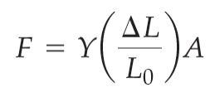
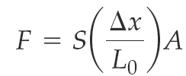
Summary of Chapter b
Stress and strain are tensors. There are different modes of elastic deformation
Force required to change the length of a solid:
Y=Young;s modulus
Force required to shear, or deform a solid:
S= shear modulus

Slide 6
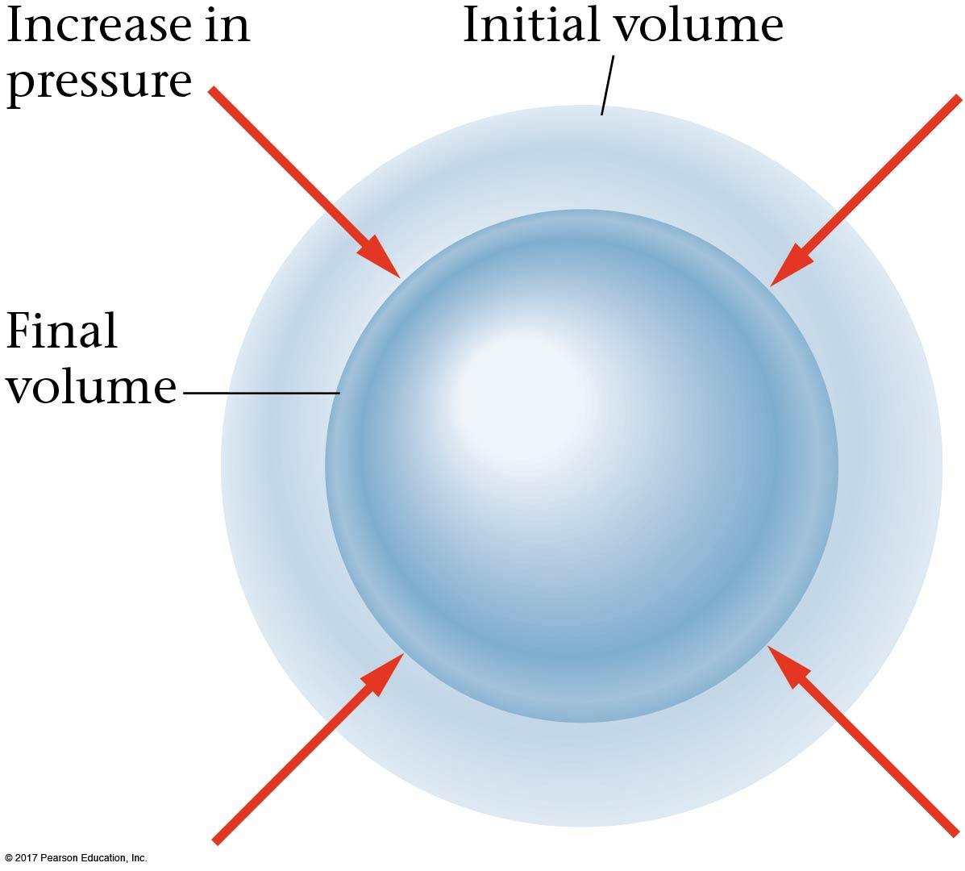
Compression
Finally, if a solid or a fluid is uniformly compressed, it will shrink.

Slide 7
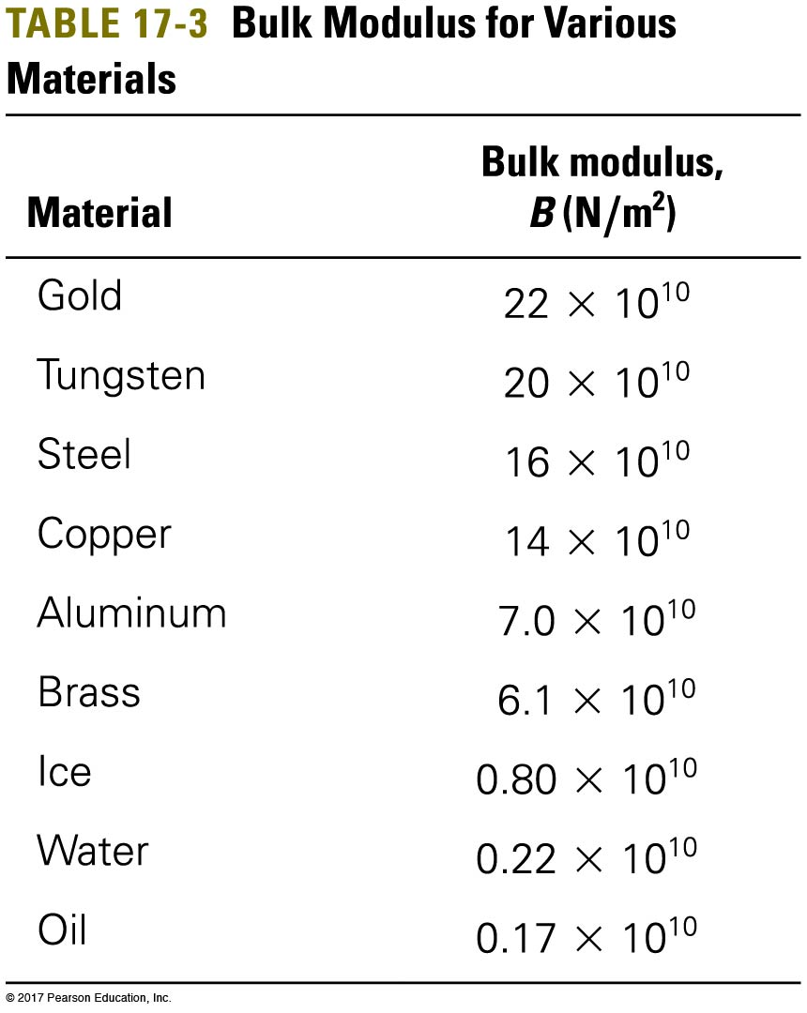
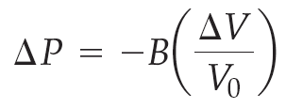
b-3 Solids and Elastic Deformation
Here, the proportionality constant, B, is called the bulk modulus.
$$B=−V dP/dV$$
Compressibility is its inverse.

Slide 8
Fluids have finite compressibilities but zero shear modulus

Slide 9
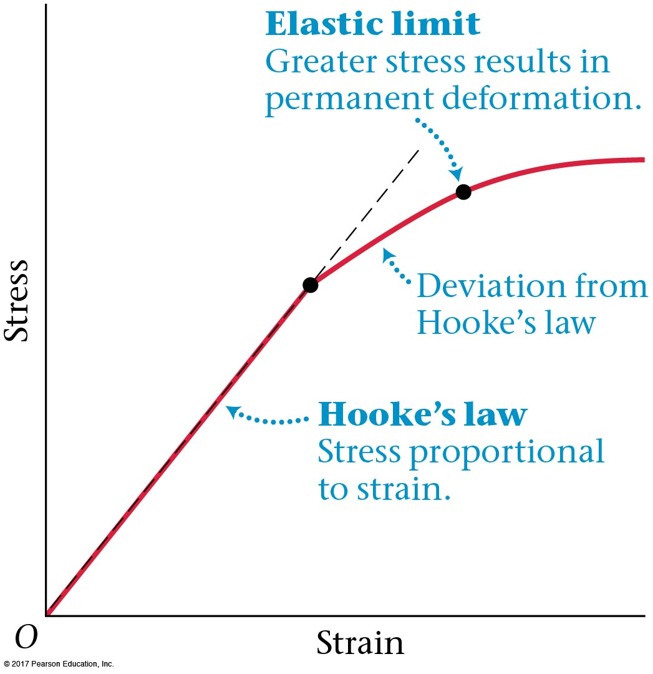
b-3 Elastic limit
The applied force per unit area is called the stress, and the resulting deformation per unit length is the strain. They are proportional to each other until the stress becomes too large; permanent deformation will then occur.

Slide 10
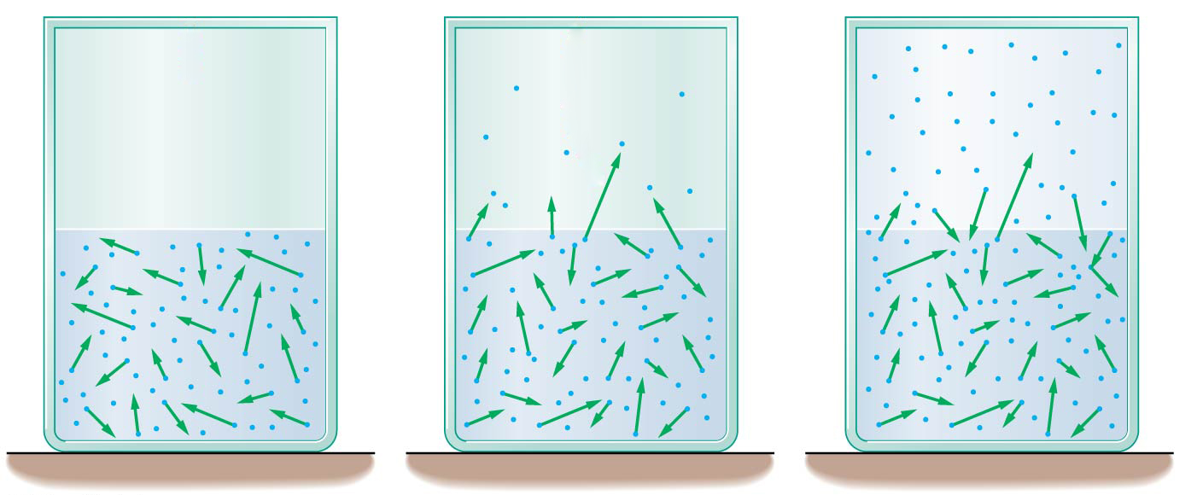
b-4 Phase Equilibrium and Evaporation
If a liquid is put into a sealed container so that there is a vacuum above it, some of the molecules in the liquid will vaporize. Once a sufficient number have done so, some will begin to condense back into the liquid. Equilibrium is reached when the numbers remain constant.

Slide 11
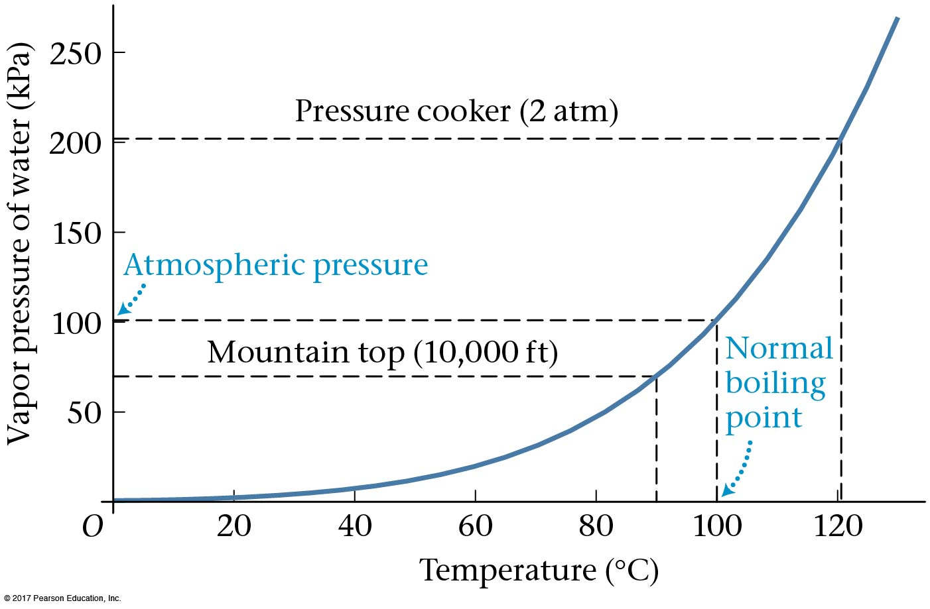
b-4 Phase Equilibrium and Evaporation
The pressure of the gas when it is in equilibrium with the liquid is called the equilibrium vapor pressure, and it will depend on the temperature.

Slide 12
b-4 Phase Equilibrium and Evaporation
The vaporization curve determines the boiling point of a liquid:
A liquid boils at the temperature at which its vapor pressure equals the external pressure.
This explains why water boils at a lower temperature at lower pressure—and why you should never insist on a “3-minute egg” in Denver!

Slide 13
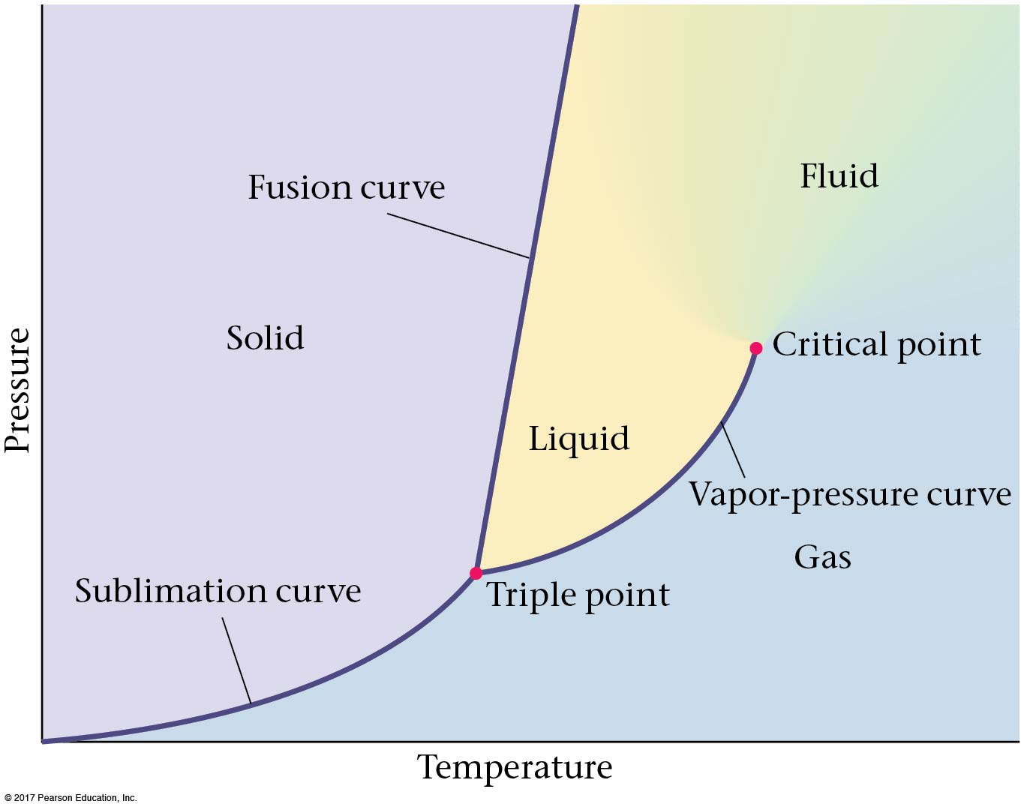
b-4 Phase Diagram
When the liquid reaches the critical point, there is no longer a distinction between liquid and gas; there is only a “fluid” phase. Below, the liquid and the gas have differeny densities. The density changes discontinuously as the boundary is crossed.

Slide 14
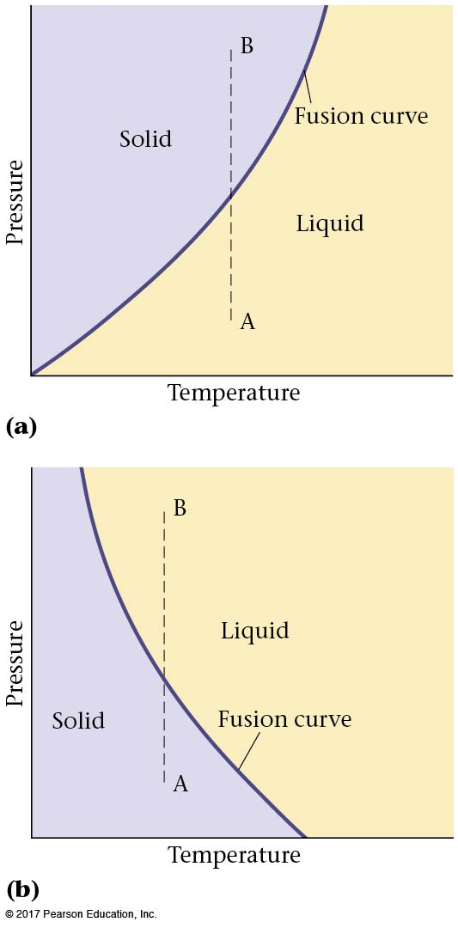
b-4 Melting Curve
The fusion/melting curve is the boundary between the solid and liquid phases; along that curve they exist in equilibrium with each other. Solid becomes liquid as the temperature is increased. Almost all materials have a fusion curve that resembles (a). Liquid under pressure becomes solids.
Water, due to its unusual properties near the freezing point, follows (b) ice under pressure becomes water.

Slide 15
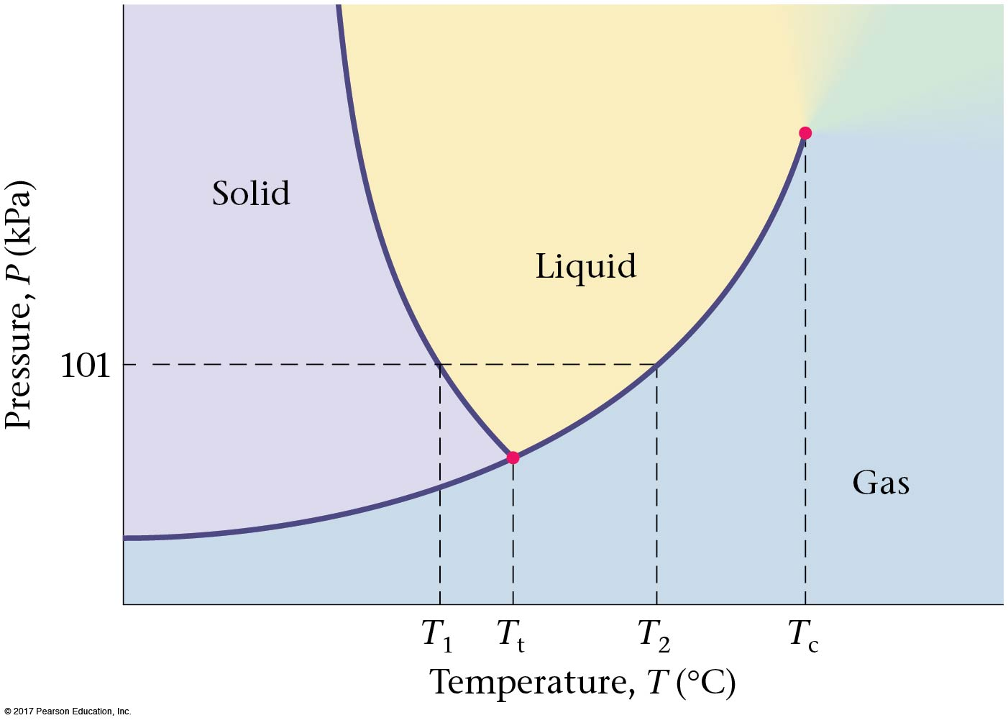
b-4 Phase Diagram
Finally, the sublimation curve marks the boundary between the solid and gas phases. The triple point, T_{t}, is where all three phases are in equilibrium. This is shown on the phase diagram for water shown on the right.

Slide 16
b-4 Phase Diagram
When the liquid reaches the critical point, there is no longer a distinction between liquid and gas; there is only a “fluid” phase. The density changes continuously around the critical point

Slide 17
Magnet phase diagram
H M
X Critical point T

Slide 18
Properties at the critical point have the same symmetry for the liquid –gas and the magnetic transitions
Liquid gas transition ~ magnetic transition
Liquid~ spin up, gas ~spin down
Density difference ~ magnetization

Slide 19
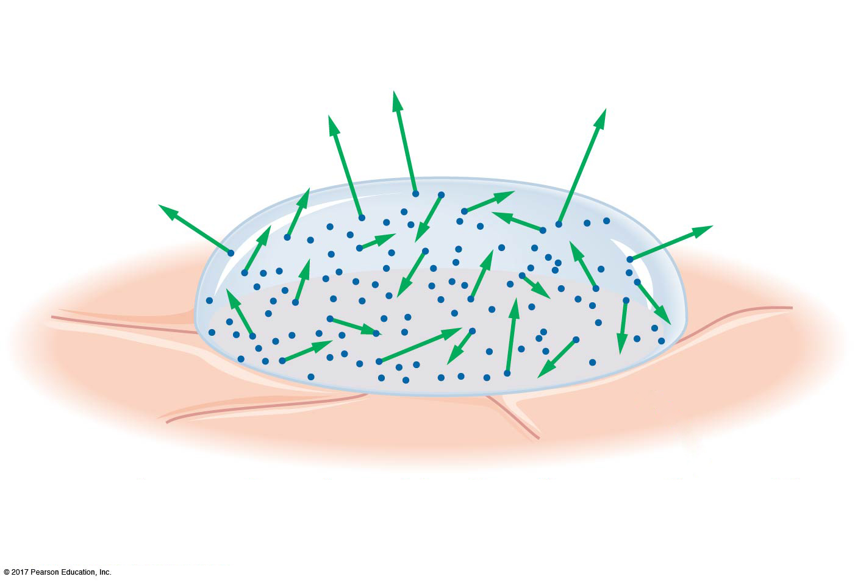
b- Evaporative cooling
A liquid in a closed container will come to equilibrium with its vapor. However, an open liquid will not, as its vapor keeps escaping—it will continue to vaporize without reaching equilibrium. As the molecules that escape from the liquid are the higher-energy ones, this has the effect of cooling the liquid. This is why sweating cools us off. This evaporative
cooling is used to cool atoms to nano (10^-9) K

Slide 20
Evaporative cooling

Slide 21
You step out of a swimming pool on a hot day, where the air temperature is 90ºF. Where will you feel cooler, in Phoenix (dry) or in Philadelphia (humid)?
Equally cool in both places
Philadelphia
Phoenix
Spring Break
Notes:
Answer: C

Slide 22
You step out of a swimming pool on a hot day, where the air temperature is 90ºF. Where will you feel cooler, in Phoenix (dry) or in Philadelphia (humid)?
Equally cool in both places
Philadelphia
Phoenix
In Phoenix, where the air is dry, more of the water will evaporate from your skin. This is a phase change, where the water must absorb the heat of vaporization, which it takes from your skin. That is why you feel cool as the water evaporates.
Spring Break

Slide 23
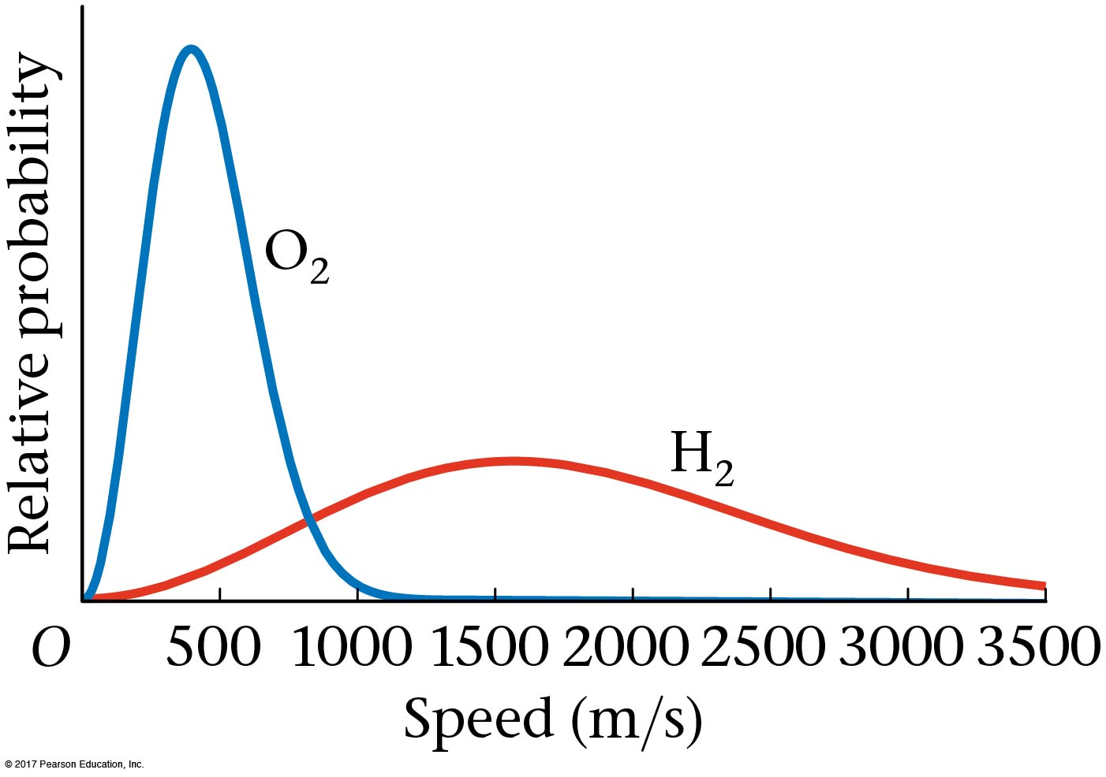
Evaporating atmosphere
This same evaporation process can cause a planet to lose its atmosphere—some molecules will have speeds exceeding the escape velocity. The evaporation process will be faster for lighter molecules and for less massive planets.

Slide 24
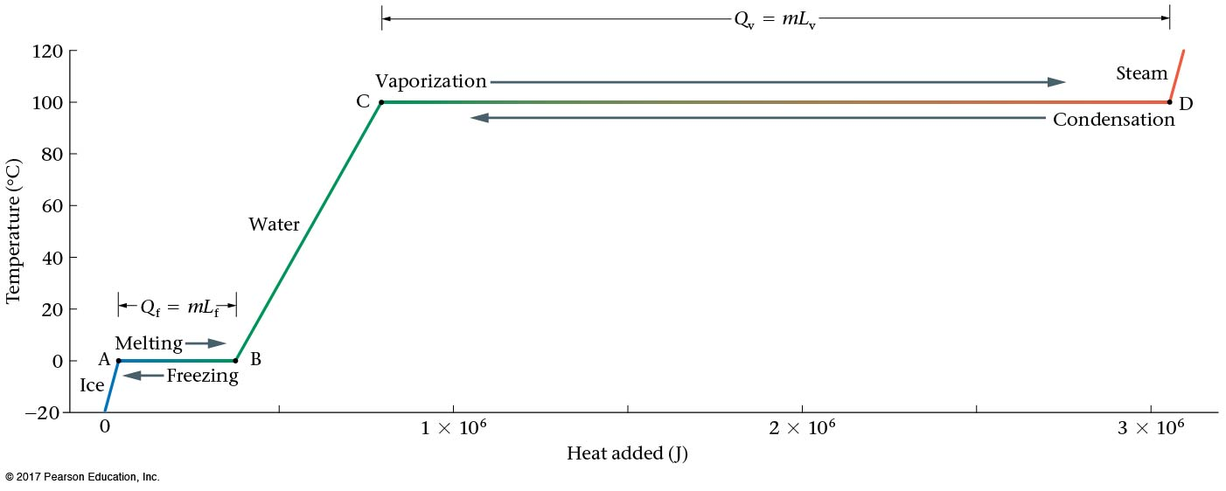
b-5 Latent Heats
When two phases coexist, the temperature remains the same even if a small amount of heat is added. Instead of raising the temperature, the heat goes into changing the phase of the material—melting ice, for example.

Slide 25
b-5 Latent Heats
The heat required to convert from one phase to another is called the latent heat.
The latent heat, L, is the heat that must be added to or removed from one kilogram of a substance to convert it from one phase to another. During the conversion process, the temperature of the system remains constant.
Latent heat of evaporation for water $22.6×{10}^{5}$J/kg

Slide 26
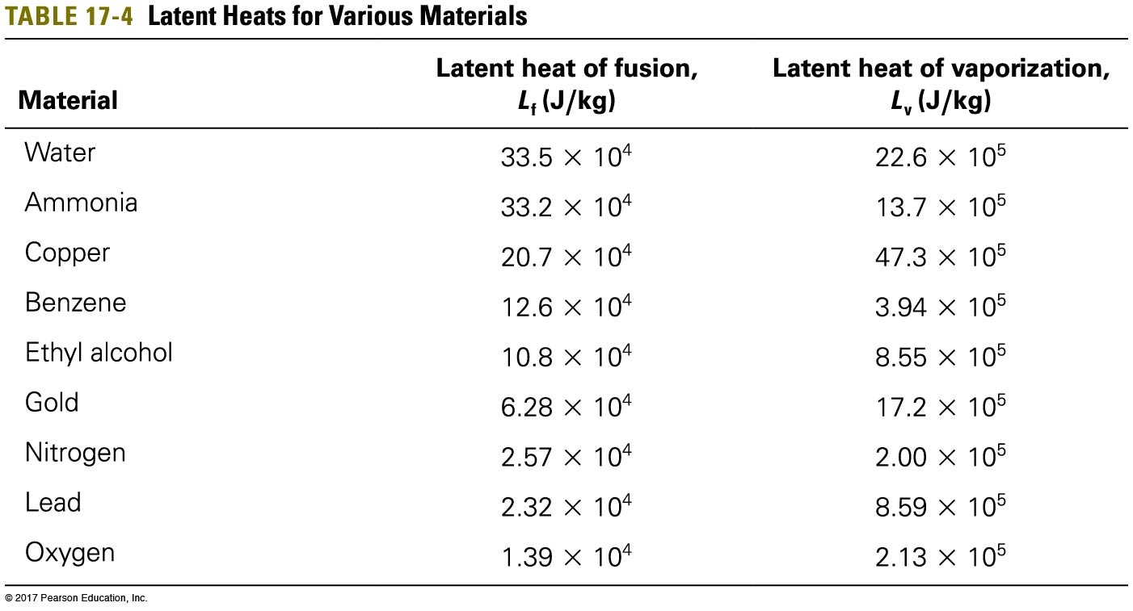
b-5 Latent Heats
The latent heat of fusion is the heat needed to go from solid to liquid; the latent heat of vaporization from liquid to gas:

Slide 27
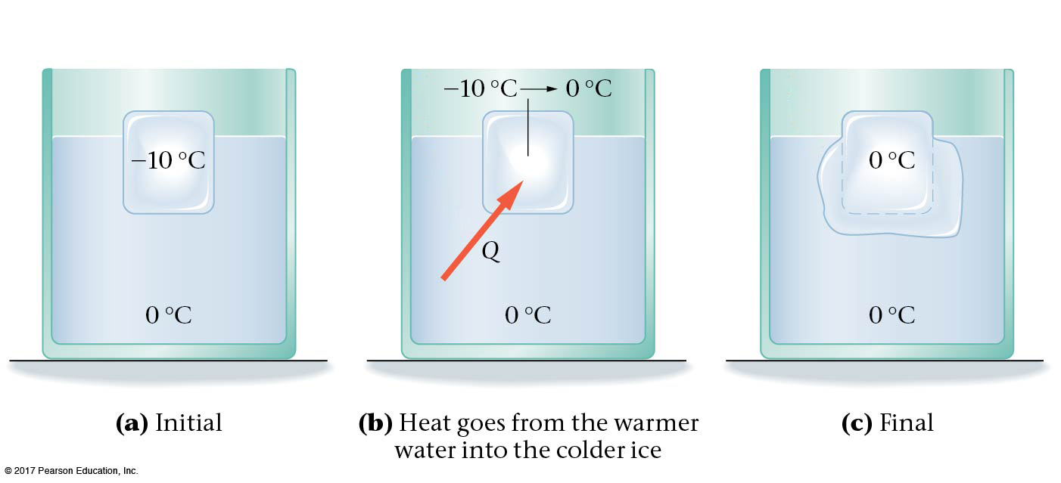
b-6 Phase Changes and Energy Conservation
Solving problems involving phase changes is similar to solving problems involving heat transfer, except that the latent heat must be included as well.

Slide 28
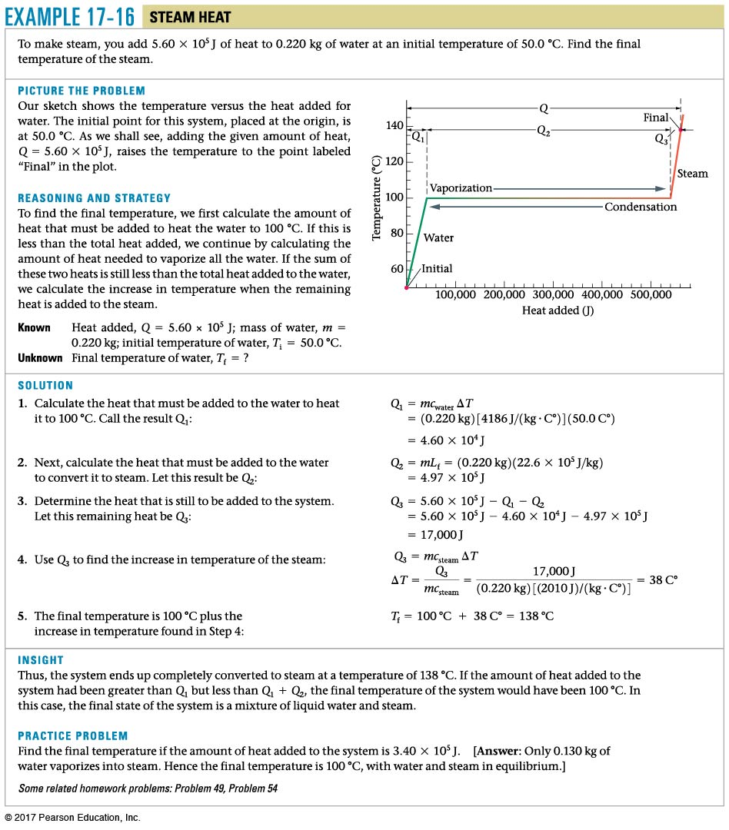
Example b.16

Slide 29
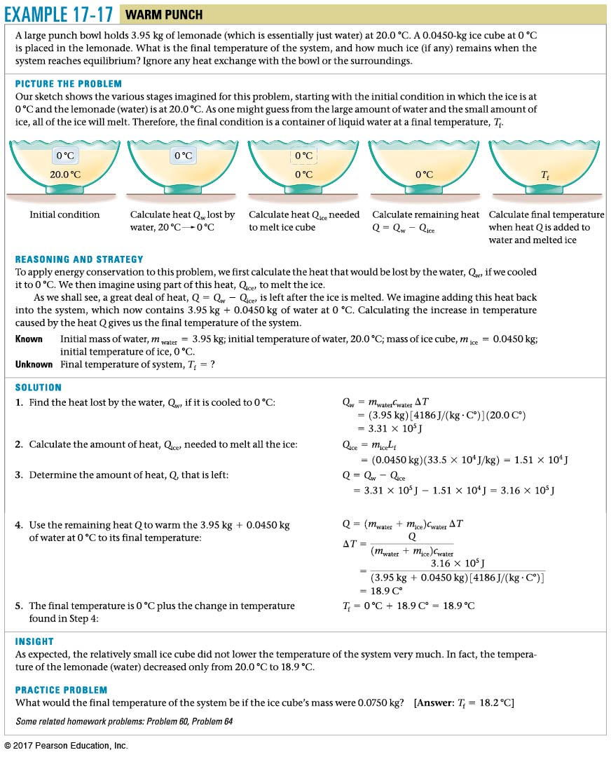
Example b.b
Calirometry with ice
(20-T)c Mw=Mi[ L+(T-0)c]
T=Q/[c(Mw+Mi)]
20cMw-MiL=Q

Slide 30
You put 1 kg of ice at 0ºC together with 1 kg of water at 50ºC. What is the final temperature? L_{F} = 80 cal/g, c_{water} = 1 cal/g ºC
0ºC
Between 0ºC and 50ºC
50ºC
Greater than 50ºC
Water and Ice
Notes:
Answer: A

Slide 31
You put 1 kg of ice at 0ºC together with 1 kg of water at 50ºC. What is the final temperature? • L_{F} = 80 cal/g • c_{water} = 1 cal/g ºC
0ºC
Between 0ºC and 50ºC
50ºC
Greater than 50ºC
How much heat is needed to melt the ice? Q = mLf = (1000 g) × (80 cal/g) = 80,000 cal
How much heat can the water deliver by cooling from 50ºC to 0ºC? Q = c_{water} mΔT = (1 cal/g ºC) × (1000 g) × (50ºC) = 50,000 cal Thus, there is not enough heat available to melt all the ice!
Follow-up: How much more water at 50ºC would you need?
Water and Ice

Slide 32
Chapter c The Laws of Thermodynamics

Slide 33
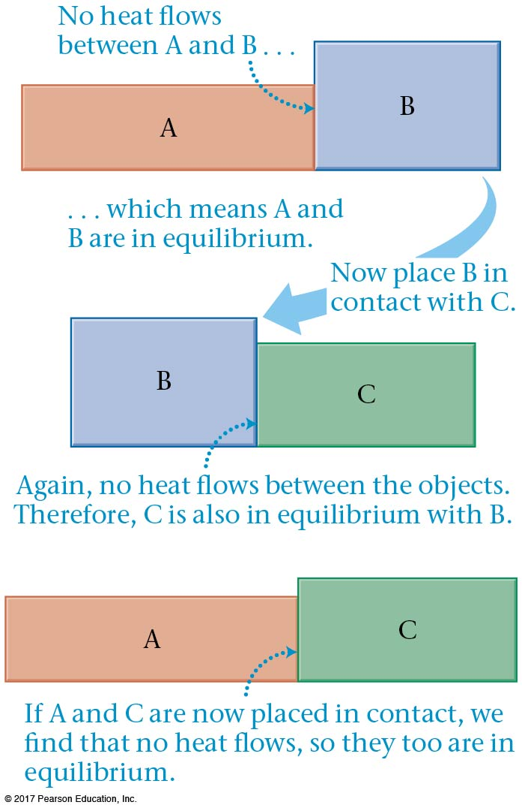
c-1 The Zeroth Law of Thermodynamics
We have already discussed the zeroth law, and include it here for completeness:
If object A is in thermal equilibrium with object B, ${(T}_{A}=T_{B})$and object B is separately in thermal equilibrium with object C ${(T}_{C}=T_{B})$, then objects A and C will be in thermal equilibrium ${(T}_{A}=T_{C })$if they are placed in thermal contact.

Slide 34
A small object, A, has the same temperature as a larger object, B. If the two are brought into thermal contact, which direction will heat flow?
From A to B
From B to A
There is no heat flow
Zeroth Law
Notes:
Answer: C

Slide 35
A small object, A, has the same temperature as a larger object, B. If the two are brought into thermal contact, which direction will heat flow?
From A to B
From B to A
There is no heat flow
When the temperatures of two objects are the same, they are in thermal equilibrium and there will be no heat flow! This is true regardless of their relative mass. This is essentially a statement of the zeroth law of thermodynamics
Zeroth Law

Slide 36
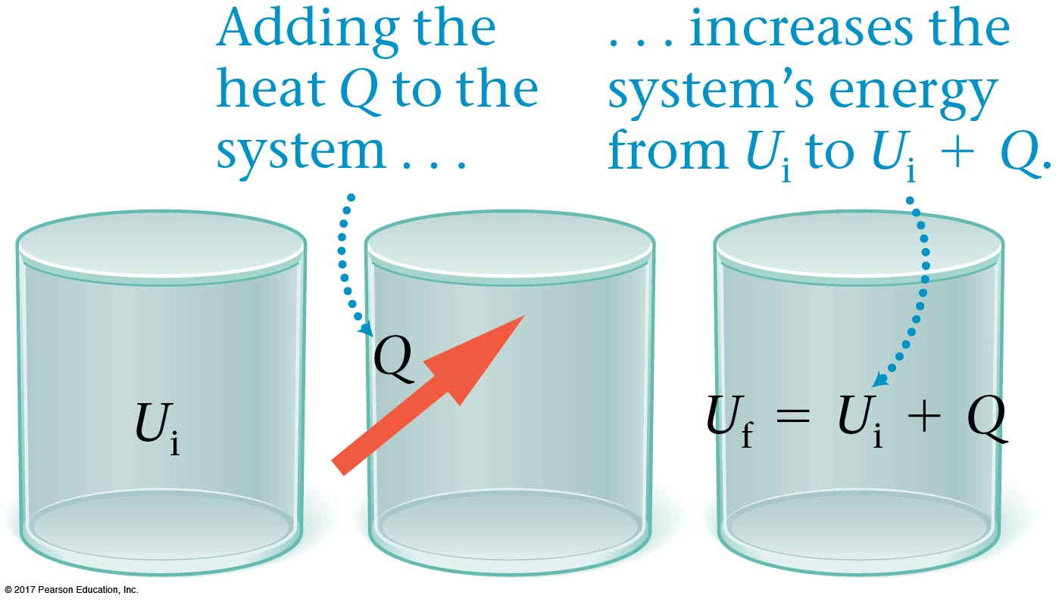
c-2 The First Law of Thermodynamics
The first law of thermodynamics is a statement of the conservation of energy.
If a system’s volume is constant, and heat is added, its internal energy increases.

Slide 37
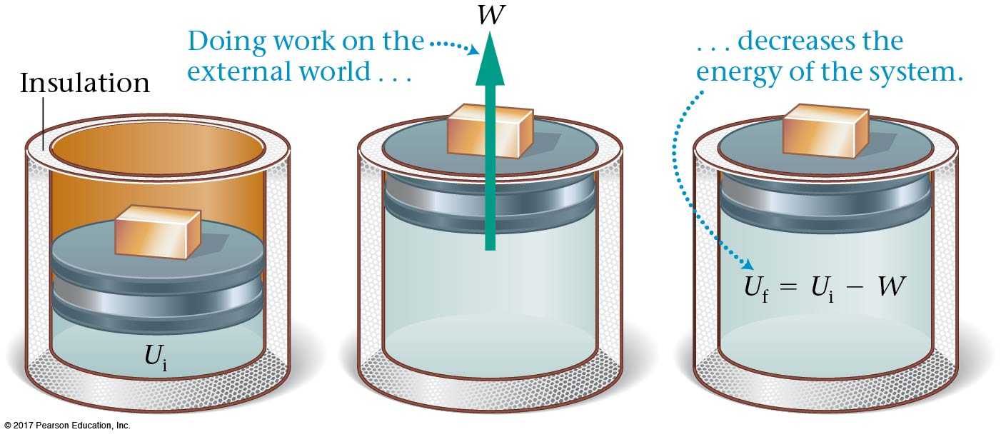
c-2 The First Law of Thermodynamics
If a system does work on the external world, and no heat is added, its internal energy decreases .
Work $W=F∆x=PA$ $∆x=P∆V$

Slide 38
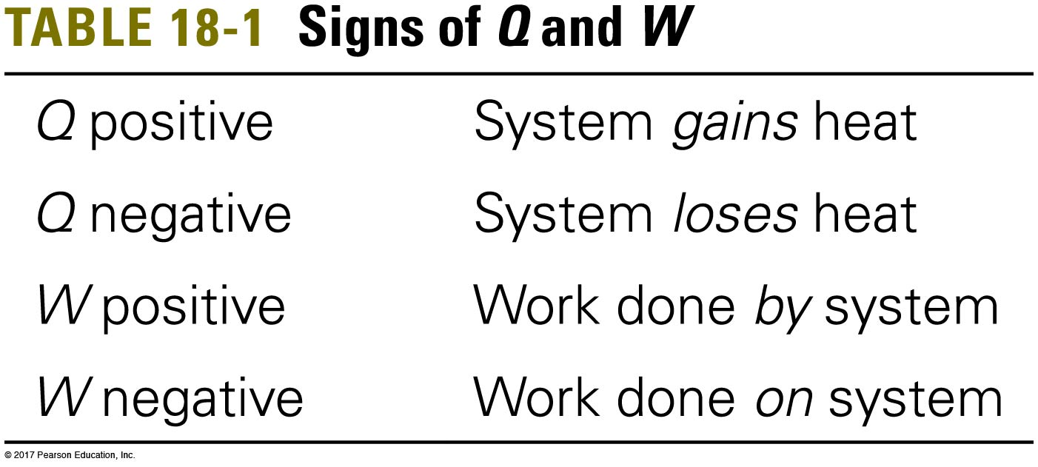
c-2 The First Law of Thermodynamics
Combining these gives the first law of thermodynamics. The change in a system’s internal energy is related to the heat Q and the work W as follows: [dU=dQ-PdV]
It is vital to keep track of the signs of Q and W.

Slide 39
The First Law of Thermodynamics dU=TdS-PdV
dU=dQ-PdV
Recall that the temperature is defined by
$\frac{1}{T}=dS/dU$ when dV=0
Thus dQ=TdS

Slide 40
Example c.1

Slide 41
Which of the following is possible?
Heat is added to a system and the internal energy decreases.
Heat is added to a system and the internal energy increases.
Heat is added to a system and the internal energy remains the same.
All of the above
First Law
Notes:
Answer: D

Slide 42
Which of the following is possible?
Heat is added to a system and the internal energy decreases.
Heat is added to a system and the internal energy increases.
Heat is added to a system and the internal energy remains the same.
All of the above
The first law is given by:
∆U = Q – W
However, in these three situations, the work is not given, so it is possible that even though Q is positive, the total ∆U could be either positive, negative, or zero.
First Law

Slide 43
c-2 The First Law of Thermodynamics
The internal energy of the system depends only on its temperature. The work done and the heat added, however, depend on the details of the process involved.

Slide 44
c-3 Thermal Processes: Ways in which the system can change
In everyday lives, the state of a system, such as its temperature, pressure, volume,… will change.
For example, this happened in steam engines, power generation, etc. Refrigerators, air conditioners, and heat pumps all use work to transfer heat from a cold object to a hot object.
We shall try to understand and describe these changes by focusing on one change at a time.

Slide 45
c-3 Thermal Processes: Ways in which the system can change
We will assume that all processes we discuss are quasi-static—they are slow enough that the system is always in equilibrium.
We also assume they are reversible:
For a process to be reversible, it must be possible to return both the system and its surroundings to exactly the same states they were in before the process began.

Slide 46
Isothermal Constant Temperature Process
This is an idealized reversible process. The gas is compressed; the heat leaves the gas. (refrigerator) Reverse: the gas expands and does work, heat is drawn from the reservoir,(steam engine).
Internal energy that is a function of temperature is unchanged.The piston is assumed frictionless.

Slide 47
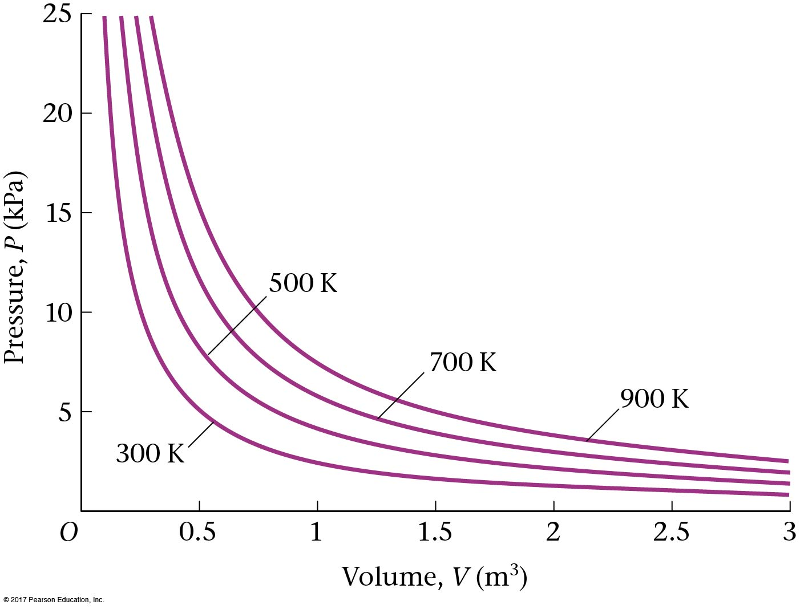
Constant Temperature Process,
If the temperature is constant for an ideal gas (pV=nRT), the pressure varies inversely with the volume.

Slide 48
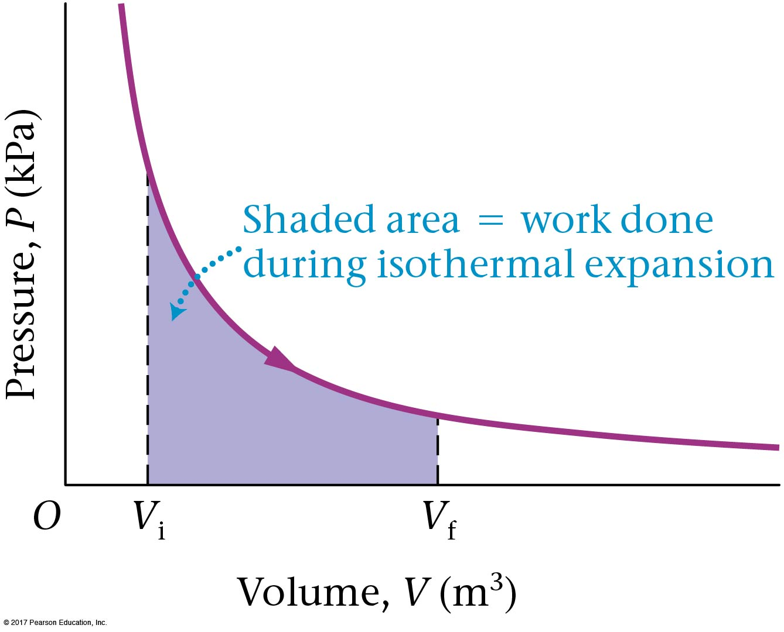
Constant Temperature Process
Internal energy that is a function of temperature is unchanged. $∆U\left(T\right)=W−Q=0$. The work done $W=\sum{P∆V}$ is the area under the curve:

Slide 49
Example c.5

Slide 50
F=U-TS. Because dU=dW+TdS, dF=dW-SdT For isothermal processes dT=0, dF=dW.

Slide 51
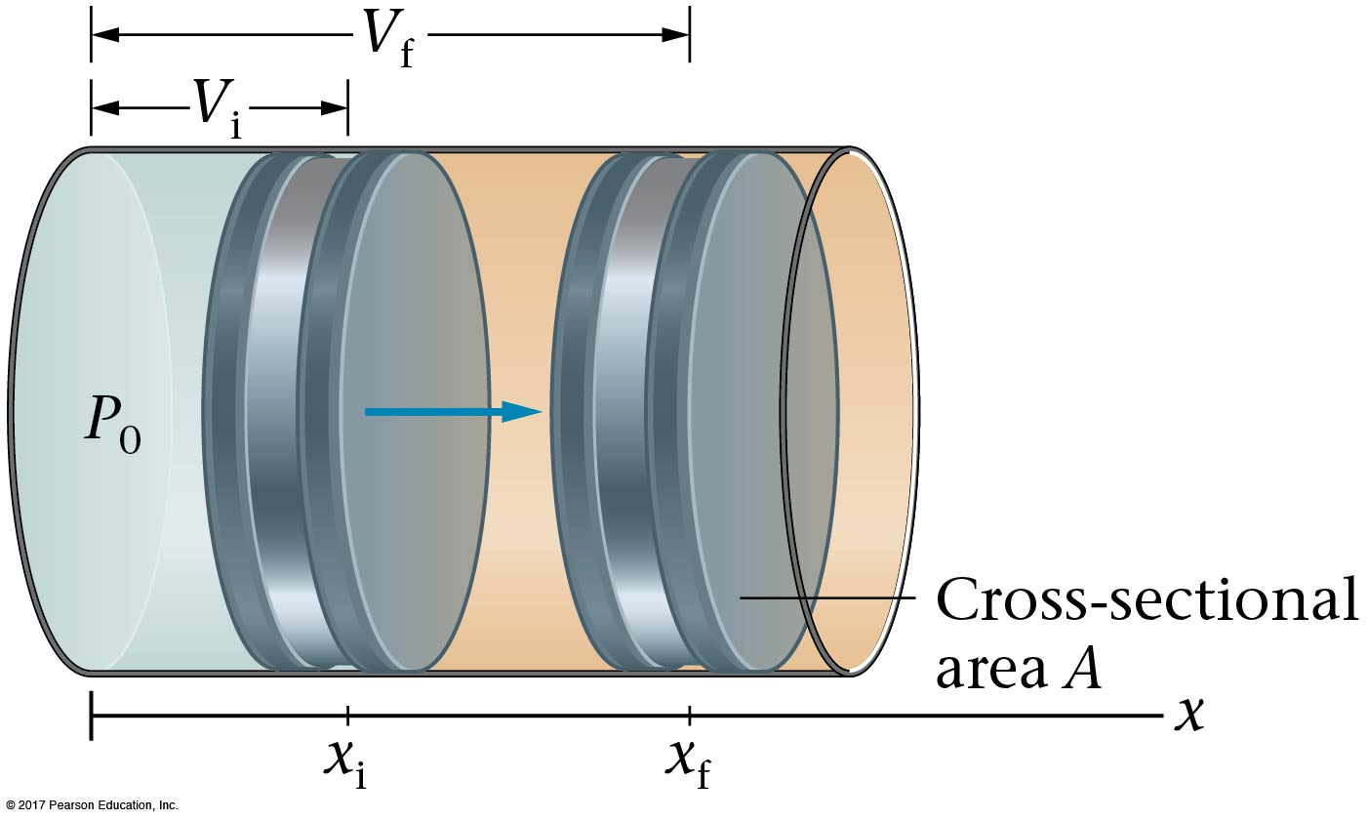
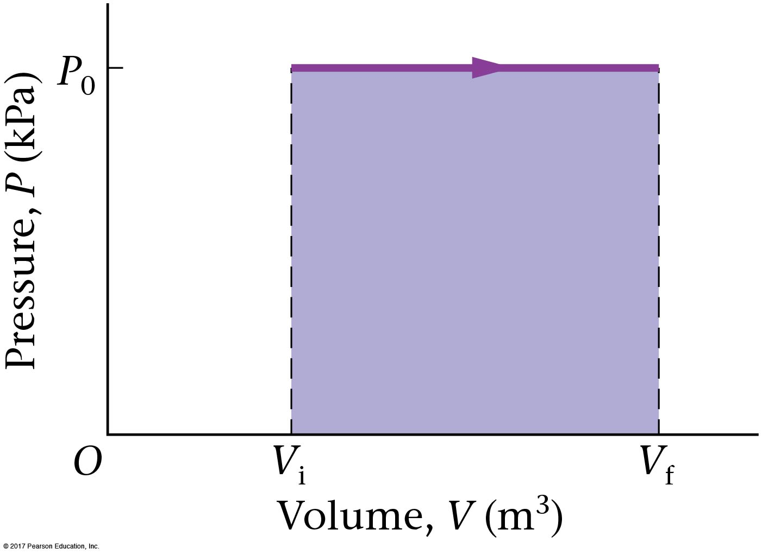
Constant Pressure Process
Work done by an expanding gas, constant pressure:

Slide 52
Example c.3

Slide 53
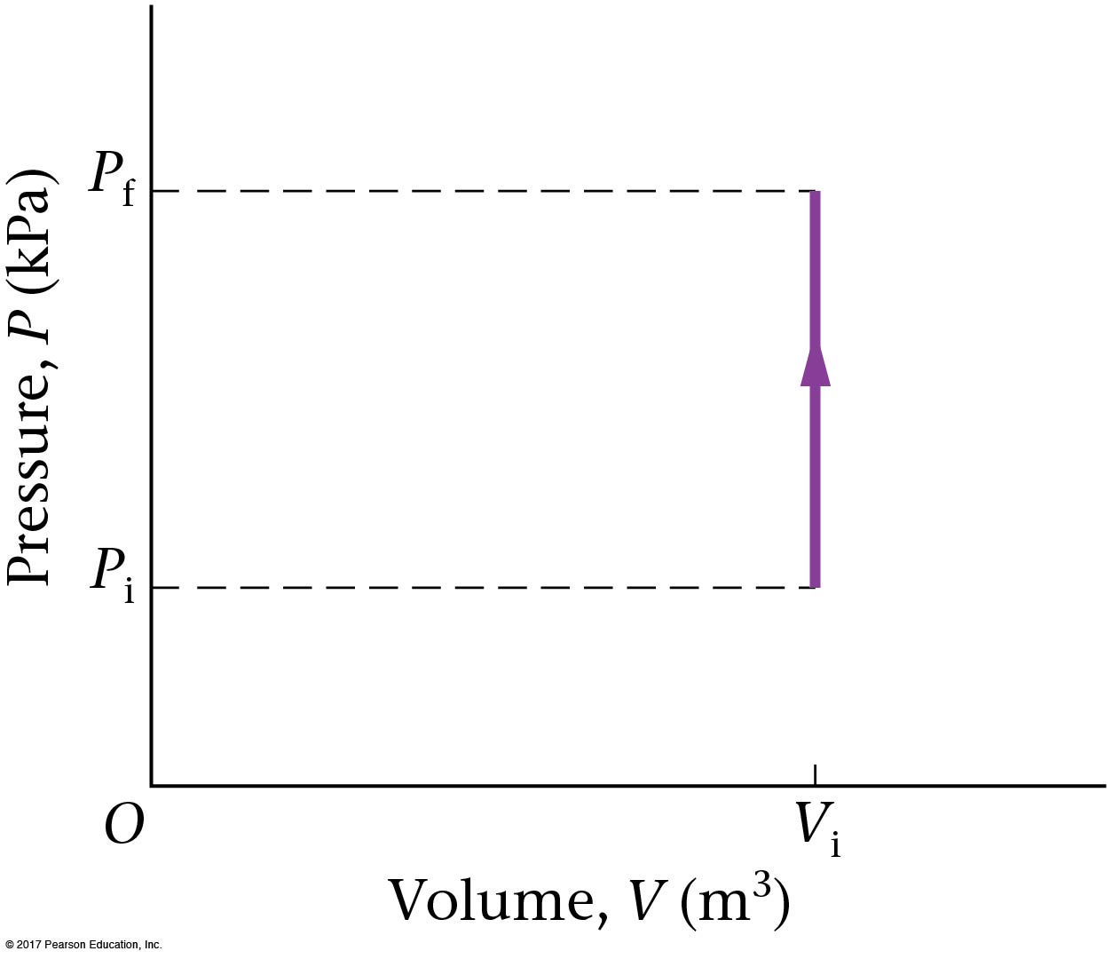
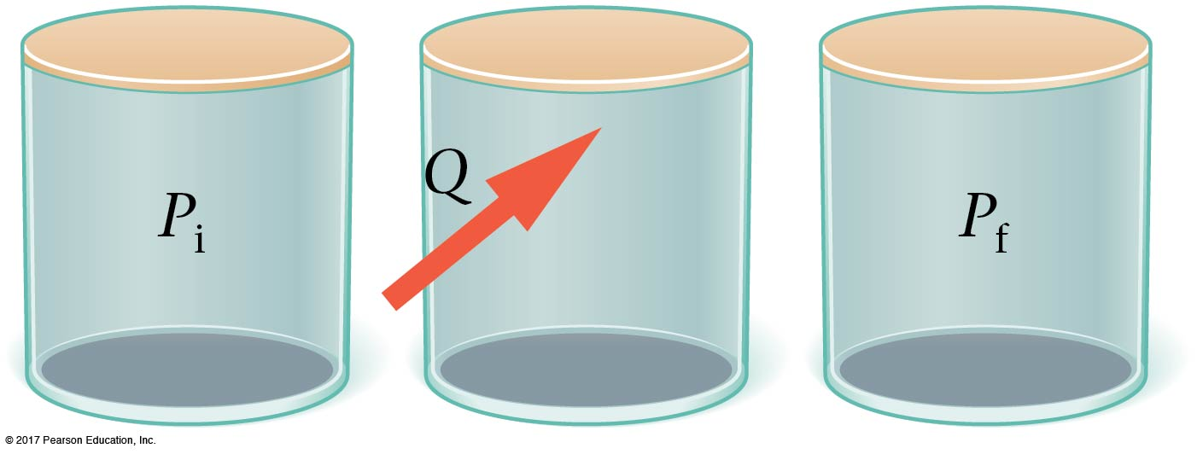
Constant Volume Process
If the volume stays constant, nothing moves and no work is done.

Slide 54
Adiabatic process
An adiabatic process is one in which no heat flows into or out of the system. The adiabatic P-V curve is similar to the isothermal one but is steeper. (explained later). One way to ensure that a process is adiabatic is to insulate the system.

Slide 55
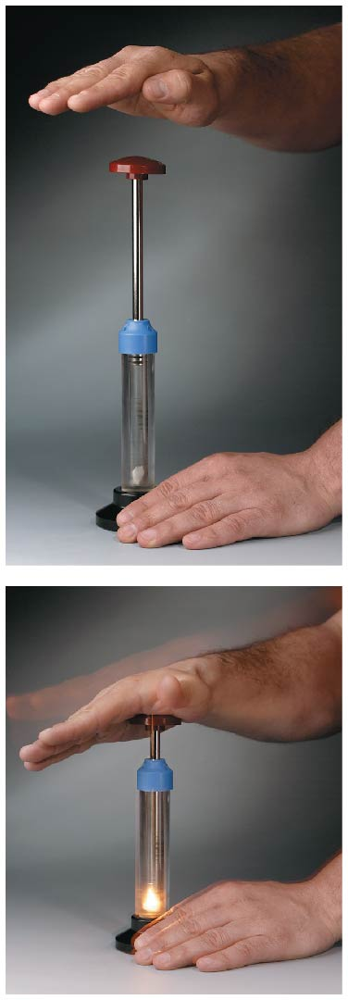
Adiabatic process
Another way to ensure that a process is effectively adiabatic is to have the volume change occur very quickly. In this case, heat has no time to flow in or out of the system.

Slide 56
c-3 Thermal Processes
Here is a summary of the different types of thermal processes:

Slide 57
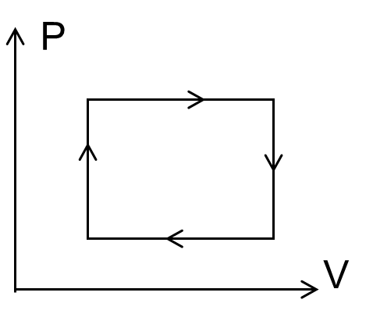
In the closed thermodynamic cycle shown in the P-V diagram, the work done by the gas is
positive.
zero.
negative.
Work
Notes:
Answer: A

Slide 58
In the closed thermodynamic cycle shown in the P-V diagram, the work done by the gas is
positive.
zero.
negative.
The gas expands at a higher pressure
and compresses at a lower pressure.
In general, clockwise = positive work;
counterclockwise = negative work.
Work

Slide 59
A gas expands adiabatically from state A to state B. If this is true, then it is true that
The temperature is constant.
No work is done on or by the gas.
The internal energy increases.
The temperature decreases.
None of the above
State Change
Notes:
Answer: D

Slide 60
A gas expands adiabatically from state A to state B. If this is true, then it is true that
The temperature is constant.
No work is done on or by the gas.
The internal energy increases.
The temperature decreases.
None of the above
In an adiabatic process:
Q = 0 -- there is no heat exchange, and as the volume increases,
W > 0 -- by the first law of thermodynamics: ∆U <0
Thus, the temperature decreases.
State Change

Slide 61
A gas is heated at constant volume from state A to state B. If this is true, then it is true that
the internal energy is constant.
no work is done on or by the gas.
the internal energy decreases.
no heat is added or lost by the system.
none of the above
State Change
Notes:
Answer: B

Slide 62
A gas is heated at constant volume from state A to state B. If this is true, then it is true that
the internal energy is constant.
no work is done on or by the gas.
the internal energy decreases.
no heat is added or lost by the system.
none of the above
In a constant volume process:
W = 0 -- there is no volume change so there is no work.
Q is >0 as heat is added and by the first law of thermodynamics:
∆U is >0
State Change

Slide 63
A gas expands isothermally from state A to state B. If this is true, then it is true that
the system does not add or lose heat.
no work is done on or by the gas.
the internal energy increases.
the gas does positive work.
none of the above.
State Change
Notes:
Answer: D

Slide 64
A gas expands isothermally from state A to state B. If this is true, then it is true that
the system does not add or lose heat.
no work is done on or by the gas.
the internal energy increases.
the gas does positive work.
none of the above.
In an isothermal expansion process:
∆U = 0 -- there is no temperature change, so there is no change in internal energy. The work is given by the equation:
W= nRT ln(V_{f}/V_{i}) which for an expansion is > ; the gas does positive work. And by the first law of thermodynamics: Q = W, so Q is >0.
State Change

Slide 65
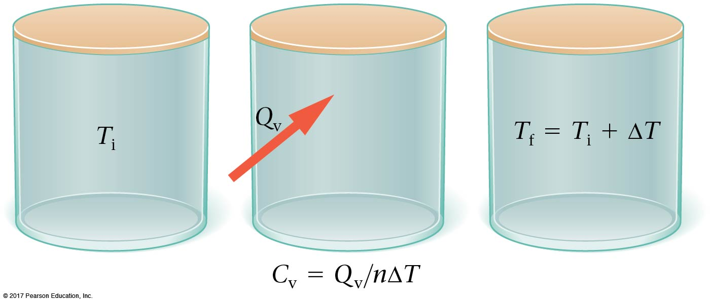
Specific Heats for an Ideal Gas: Constant Pressure, Constant Volume
Specific heats for ideal gases must be quoted either at constant pressure or at constant volume. For a constant-volume process:

Slide 66
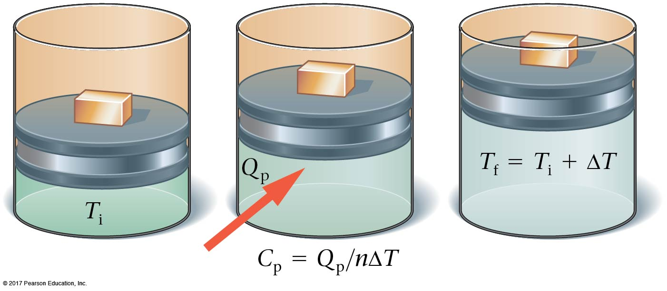
c-4 Specific Heat for an Ideal Gas at Constant Pressure
At constant pressure:

Slide 67
c-4 Specific Heats for an Ideal Gas: Constant Pressure, Constant Volume
Both C_{V} and C_{P} can be calculated for a monatomic ideal gas using the first law of thermodynamics.

Slide 68
$C_{P}$=$Q_{P}$/ $∆T/$n=5/2$R$, $C_{V}$=$Q_{V}$/ $∆T/$n=$3/2R$ $C_{P}−C_{V}$=$R$
Constant P
PV=nRT
$W=P$ $∆V=nR∆T$,
U=3/2 nRT, $∆U=\frac{3}{2}nR∆T$
$Q_{P}=∆U+W=\frac{5}{2}nR∆T$,
Constant V
$W=P$ $∆V=0$
$Q_{V}=∆U+W=$ $∆U=\frac{3}{2}nR∆T$,

Slide 69
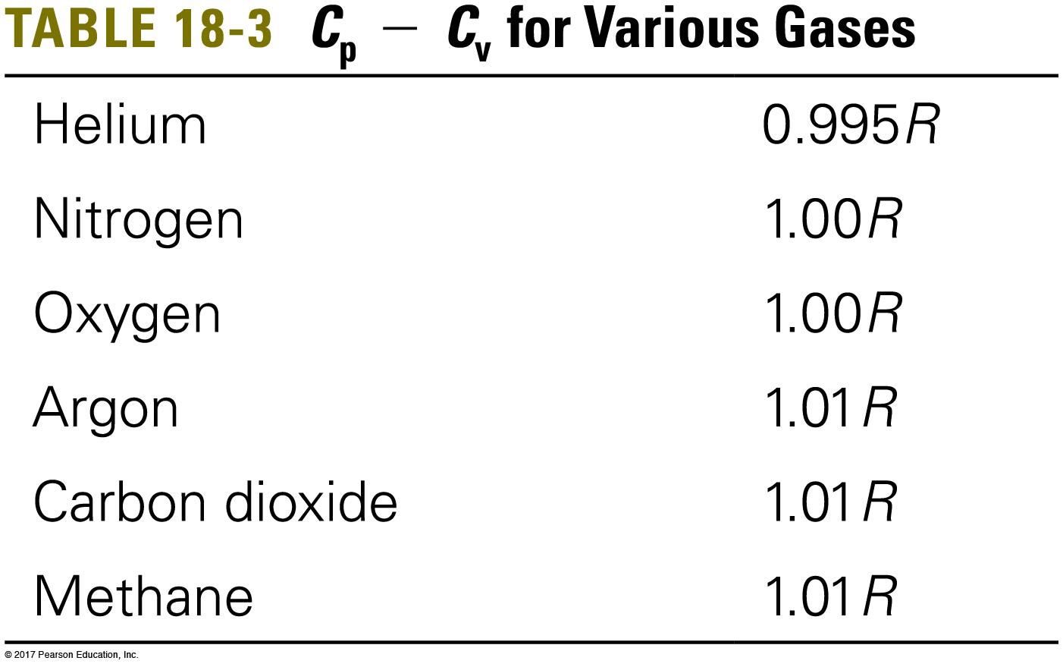
c-4 Specific Heats for an Ideal Gas: Constant Pressure, Constant Volume
Although this calculation was done for an ideal, monatomic gas, it works well for real gases.

Slide 70
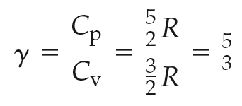
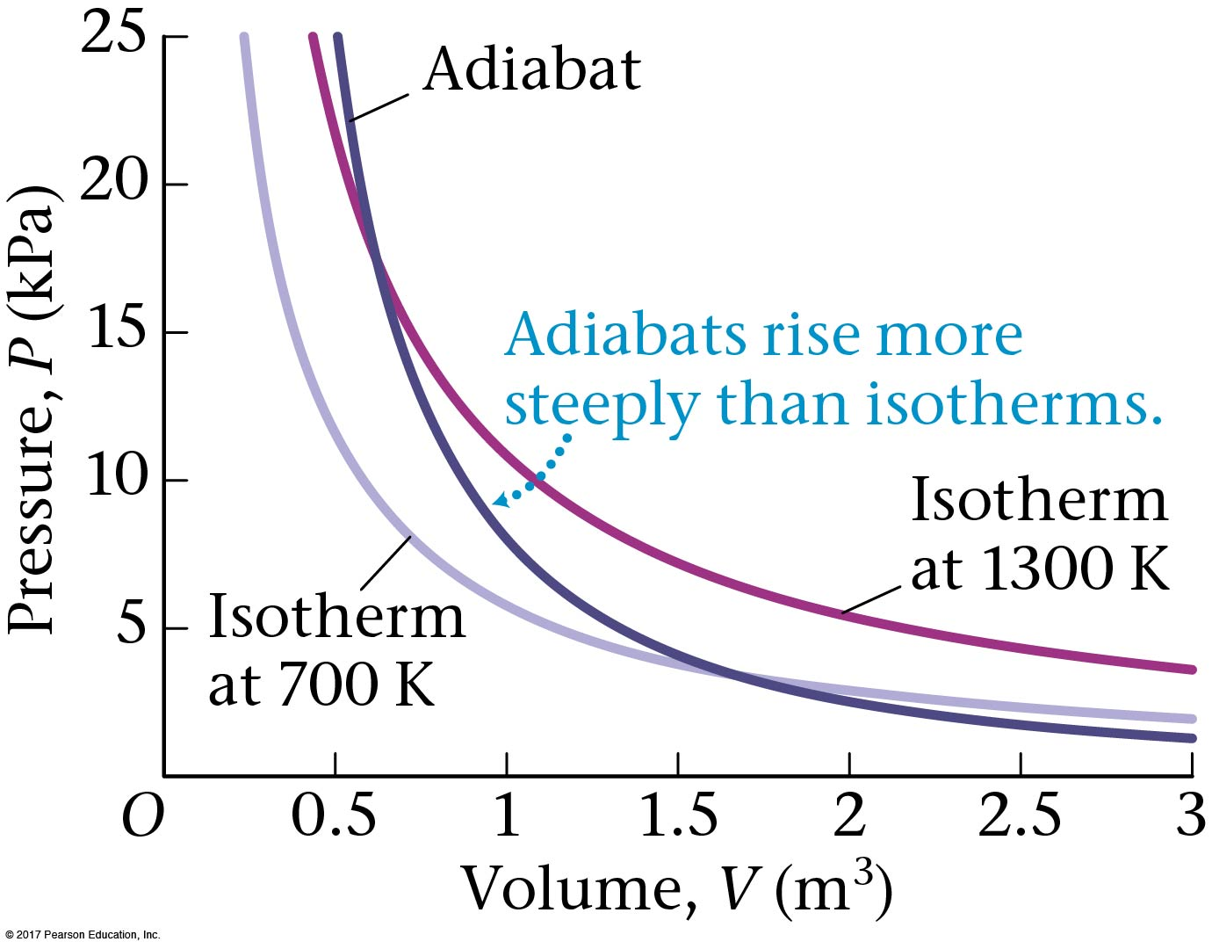
c-4 Adiabatic process
The P-V curve for an adiabatic process is given by:
Where:
This is for a monatomic gas:

Slide 71
Adiabatic dQ=0 dU=-PdV
PV=nRT (1)
U=3/2 nRT, $dU=\frac{3}{2}nRdT$=-PdV
Differentiating (1), e get
$PdV+VdP=nRdT=−2/3PdV$,
$γdV/V=− dP/P$,
$γ\ln{V}=−\ln{P+constant}$,

Slide 72
Example c.10

Slide 73
An example: Carnot cycle: $\frac{Q_{1}}{T_{1}}=\frac{Q_{2}}{T_{2}}=∆S$ Significance will be explained later
Simple engine has four processes ab, cd isothermal
$$Q_{1}=W_{1}=nRT_{1}ln(\frac{V_{b}}{V_{a}})$$
$$Q_{2}=W_{2}=nRT_{2}ln(\frac{V_{c}}{V_{d}})$$
bc, da adiabatic,
$PV^{γ}=const$, pV=nRT,
$T_{1}V_{b}^{γ−1}=T_{2}V_{c}^{γ−1}$, $T_{2}V_{d}^{γ−1}=T_{1}V_{a}^{γ−1}$
$\frac{V_{b}}{V_{a}}=\frac{V_{c}}{V_{d}}$, we get : $\frac{Q_{1}}{T_{1}}=\frac{Q_{2}}{T_{2}}$

Slide 74
c-5 The Second Law of Thermodynamics
We observe that heat always flows spontaneously from a warmer object to a cooler one, although the opposite would not violate the conservation of energy. This direction of heat flow is one of the ways of expressing the second law of thermodynamics:
When objects of different temperatures are brought into thermal contact, the spontaneous flow of heat that results is always from the high temperature object to the low temperature object. Spontaneous heat flow never proceeds in the reverse direction.

Slide 75
Approach to equilibrium (2nd law) : Entropy = ln (number of configurations) always increases
If $T_{s}≠T_{B}$, the number of configurations is not at a maximum and the system will move to a new state with larger number of configurations.
$\frac{dN}{dE}=dE_{s}\left(\frac{1}{\text{Ts}}−\frac{1}{\text{T}B}\right)$>0
Sign of $dE_{s}$ is the opposite that of $T_{s}−T_{B}.$ If $T_{s}$ is larger , heat will flow away from it and its energy is decreased.

Slide 76
An engineer proposes an engine that essentially takes heat from the cooler ocean and powers a submarine, then expels heat to the warmer atmosphere. Does this violate the first law of thermodynamics, the second law, or both?
The first law
The second law
Both
Submarine Power
Notes:
Answer: B

Slide 77
An engineer proposes an engine that essentially takes heat from the cooler ocean and powers a submarine, then expels heat to the atmosphere. Does this violate the first law of thermodynamics, the second law, or both?
The first law
The second law
Both
This does not violate the first law of thermodynamics depending on the values of Q, but it does violate the second law of thermodynamics, as heat is flowing from the cold sea to the warmer atmosphere.
Submarine Power

Slide 78
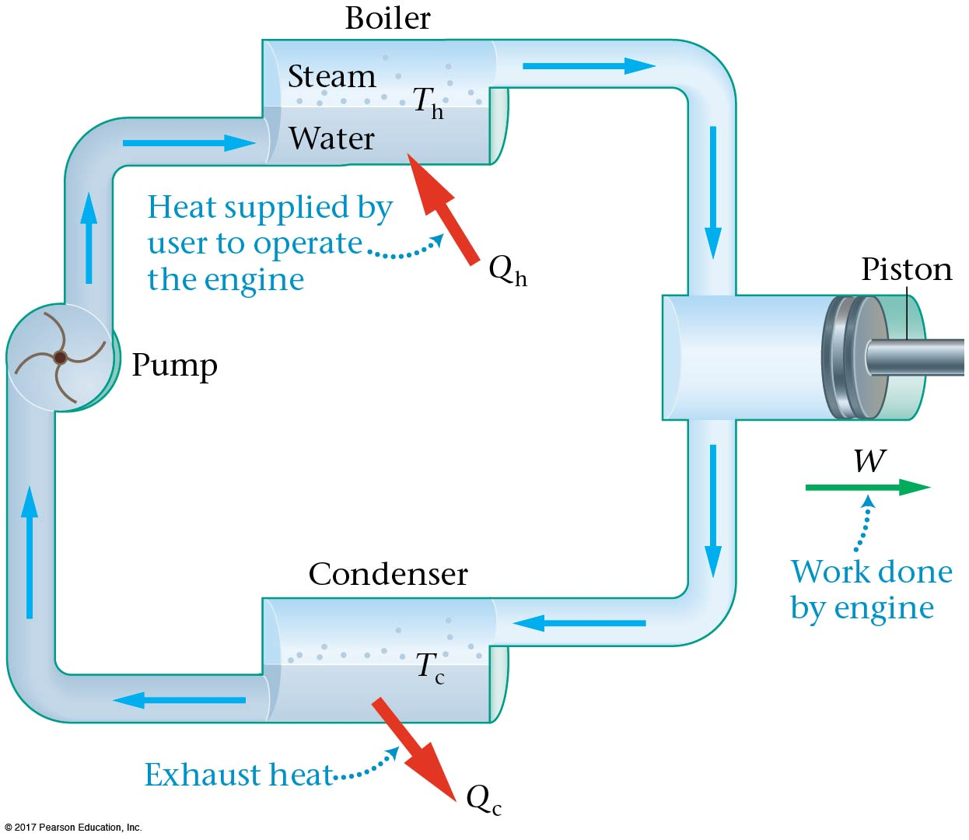
c-6 Heat Engines and the Carnot Cycle
A heat engine is a device that converts heat into work. A classic example is the steam engine. Fuel heats the water; the vapor expands and does work against the piston; the vapor condenses back into water again and the cycle repeats.

Slide 79
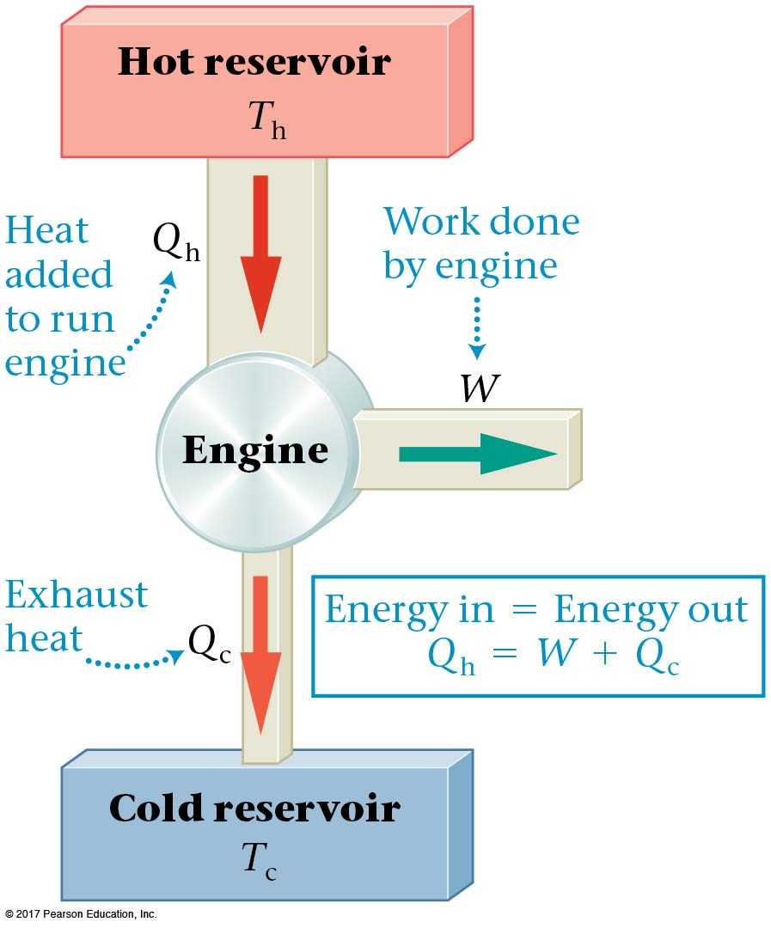
c-6 Heat Engines and the Carnot Cycle
All heat engines have:
a high-temperature reservoir.
a low-temperature reservoir.
a cyclical engine.
These are illustrated schematically here.

Slide 80
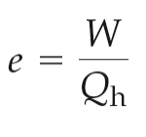
c-6 Heat Engines and the Carnot Cycle
An amount of heat Q_{h} is supplied from the hot reservoir to the engine during each cycle. Of that heat, some appear as work, and the rest, Q_{c}, is given off as waste heat to the cold reservoir.
The efficiency is the fraction of the heat supplied to the engine that appears as work:

Slide 81
c-6 Heat Engines and the Carnot Cycle
The efficiency can also be written:
In order for the engine to run, there must be a temperature difference; otherwise, heat will not be transferred.

Slide 82
c-6 Heat Engines and the Carnot Cycle
The idealized maximum-efficiency heat engine is described in Carnot’s theorem:
If an engine operating between two constant-temperature reservoirs is to have maximum efficiency, it must be an engine in which all processes are reversible. For example, if there is friction, the process is irreversible.
In addition, all reversible engines operating between the same two temperatures, T_{c} and T_{h}, have the same efficiency.

Slide 83
c-6 Heat Engines and the Carnot Cycle
If the efficiency depends only on the two temperatures, the ratio of the temperatures must be the same as the ratio of the transferred heats. Therefore, the maximum efficiency of a heat engine can be written:

Slide 84
c-6 Heat Engines and the Carnot Cycle
The maximum work a heat engine can do is then:
If the two reservoirs are at the same temperature, the efficiency is zero; the smaller the ratio of the cold temperature to the hot temperature, the closer the efficiency will be to 1.

Slide 85
Proof
$Q_{h}=T_{h}dS_{h}$
$Q_{c}=T_{c}dS_{c}$
$ϵ=\frac{Q_{h}−Q_{c}}{Q_{h}}=1−\frac{T_{c}dS_{c}}{T_{h}dS_{h}}$
From the second law, $dS_{c}$is always larger than or equal to $dS_{h}$. The maximum efficiency ocuurs when they are equal.

Slide 86
An example: Carnot cycle: $\frac{Q_{1}}{T_{1}}=\frac{Q_{2}}{T_{2}}=∆S$
Simple engine has four processes ab, cd isothermal
$$Q_{1}=W_{1}=nRT_{1}ln(\frac{V_{b}}{V_{a}})$$
$$Q_{2}=W_{2}=nRT_{2}ln(\frac{V_{c}}{V_{d}})$$
bc, da adiabatic,
$PV^{γ}=const$, pV=nRT,
$T_{1}V_{b}^{γ−1}=T_{2}V_{c}^{γ−1}$, $T_{2}V_{d}^{γ−1}=T_{1}V_{a}^{γ−1}$
$$\frac{V_{b}}{V_{a}}=\frac{V_{c}}{V_{d}}$$

