Slide 1
Summary of Chapter a
Heat is the energy transferred between objects due to a temperature difference.
Objects are in thermal contact if heat can flow between them.
Objects that are in thermal contact without any flow of heat are in thermal equilibrium.
If objects A and B are both in thermal equilibrium with C, they are in thermal equilibrium with each other.

Slide 2
Summary of Chapter a
Temperature determines whether two objects will be in thermal equilibrium.
Celsius scale: water freezes at 0ºC, boils at 100ºC.
Fahrenheit: water freezes at 32ºF, boils at 212ºF.
The lowest attainable temperature is absolute zero, - 273.15 C.
Kelvin: absolute zero is 0 K; water freezes at 273.15 K, boils at 373.15 K.

Slide 3
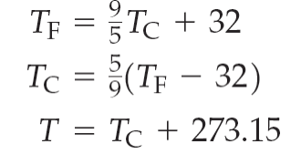
Summary of Chapter a
Temperature scale conversions:
Most substances expand when heated.
Linear expansion:
Volume expansion: , $β=3α$
Water contracts when heated from 0ºC to 4ºC.

Slide 4
Recapitulation
S(E)=ln( number of configurations with energy E.
${1/(k}_{B}T)=\frac{∂S{(E}_{})}{∂E}$.
.
In thermodynamics, an average of S is called the entropy.

Slide 5
Recapitulation: T$\text{he} \text{Boltzman} \text{canonical} \text{distribution}$: $P$=$e^{−E_{S}/k_{B}T}$
The average of a physical quantity Q ,
$<Q> =\frac{\int{dxQ\left(x\right)P\left(x\right)}}{\int{dxP\left(x\right)}};$
Angular bracket means an average.

Slide 6
Recapitulation: Free energy F
$e^{−F/kT}=\int{d\{x\}e^{−\frac{E}{k_{B}T}}}=partition function$ Z
F=U-TS
F need to be minimized for equilibrium at fixed temperature.

Slide 7
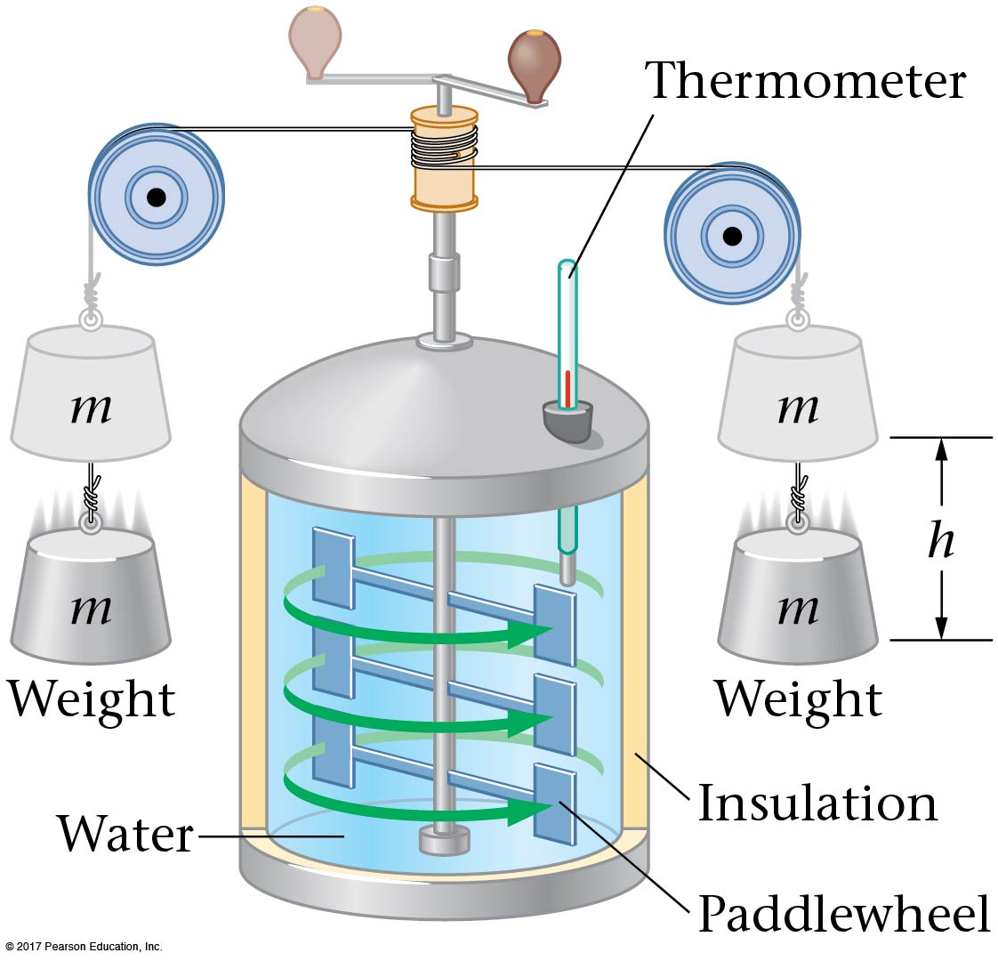
a-4 Heat and Mechanical Work
Experimental work has shown that heat is another form of energy.
James Joule used a device similar to this one to measure the mechanical equivalent of heat:

Slide 8
a-4 Heat and Mechanical Work
One kilocalorie (kcal) is defined as the amount of heat needed to raise the temperature of 1 kg of water from 14.5ºC to 15.5ºC.
Through experiments such as Joule’s, it was possible to find the mechanical equivalent:

Slide 9
a-4 Heat and Mechanical Work
Another unit of heat is the British thermal unit (Btu). This is the energy required to heat 1 lb of water from 63ºF to 64ºF:

Slide 10
a-5 Heat Capacity
The heat capacity of an object is the amount of heat added to it divided by its rise in temperature:
Q is positive if ΔT is positive, that is, if heat is added to a system.
Q is negative if ΔT is negative, that is, if heat is removed from a system.

Slide 11
a-5 Specific Heat
The heat capacity of an object depends on its mass. A quantity that is a property only of the material is the specific heat:

Slide 12
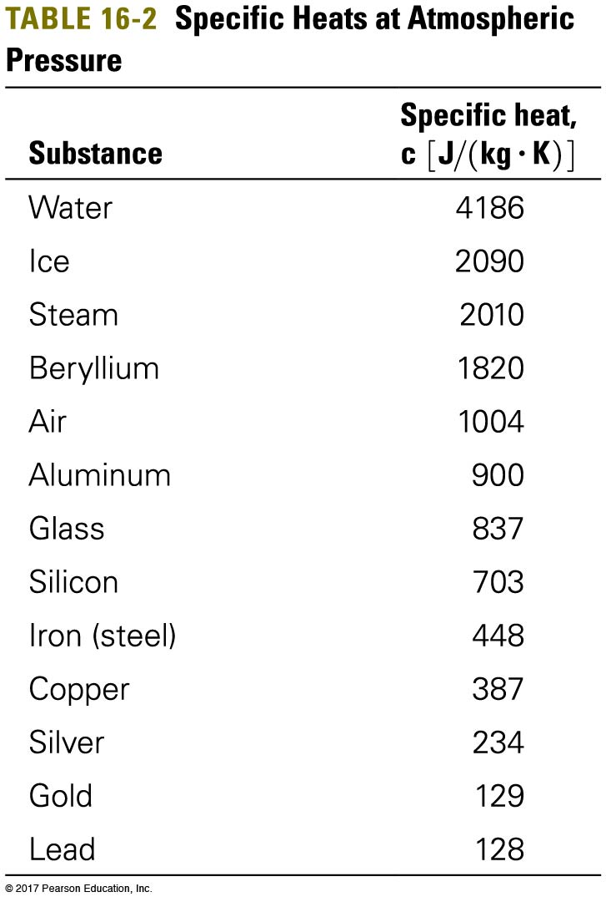
a-5 Specific Heats
Here are some specific heats of various materials:

Slide 13
a-5 Calorimetry
When an object is put in insulated flask containing water, it and the water come to thermal equilibrium. If the mass of the flask can be ignored, and the insulation keeps any heat from escaping:
The final equilibrium temperatures of the object and the water will be equal.
Heat received by water is determined by the equilibrium temperature.
Heat released by object = heat received by water.
The specific heat of the object.= heat released by object/ mass/temperature change

Slide 14
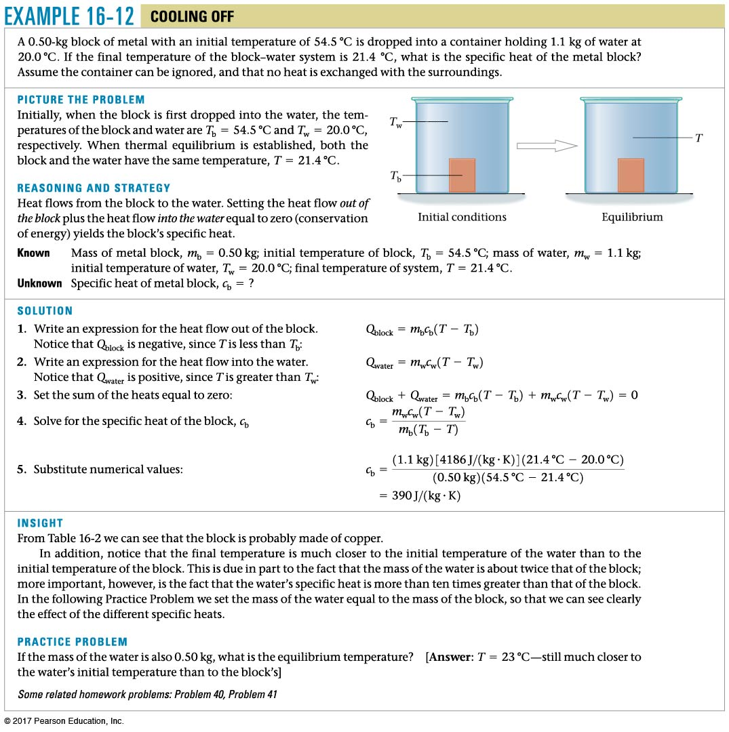
Example a.12

Slide 15
into

Slide 16
Two equal-mass liquids, initially at the same temperature, are heated for the same time over the same stove. You measure the temperatures and find that one liquid has a higher temperature than the other. Which liquid has a higher specific heat?
The cooler one
The hotter one
Both the same
Two Liquids
Notes:
Answer: A

Slide 17
Two equal-mass liquids, initially at the same temperature, are heated for the same time over the same stove. You measure the temperatures and find that one liquid has a higher temperature than the other. Which liquid has a higher specific heat?
The cooler one
The hotter one
Both the same
Both liquids had the same increase in internal energy, because the same heat was added. However, the cooler liquid had a lower temperature change.
Because Q = mcΔT, if Q and m are both the same and ΔT is smaller, then c (specific heat) must be bigger.
Two Liquids

Slide 18
1 kg of water at 100ºC is poured into a bucket that contains 4 kg of water at 0ºC. Find the equilibrium temperature (neglect the influence of the bucket).
0ºC
20ºC
50ºC
80ºC
100ºC
Calorimetry
Notes:
Answer: B

Slide 19
1 kg of water at 100ºC is poured into a bucket that contains 4 kg of water at 0ºC. Find the equilibrium temperature (neglect the influence of the bucket).
0ºC
20ºC
50ºC
80ºC
100ºC
Q₁ = Q₂
m₁cΔT₁ = m₂cΔT₂
ΔT₁/ΔT₂ = m₂/m₁
Because the cold water mass is greater, it will have a smaller temperature change!
The masses of cold/hot have a ratio of 4:1, so the temperature change must have a ratio of 1:4 (cold/hot).
Calorimetry

Slide 20
Heat transport
Conduction, Convection, and Radiation

Slide 21
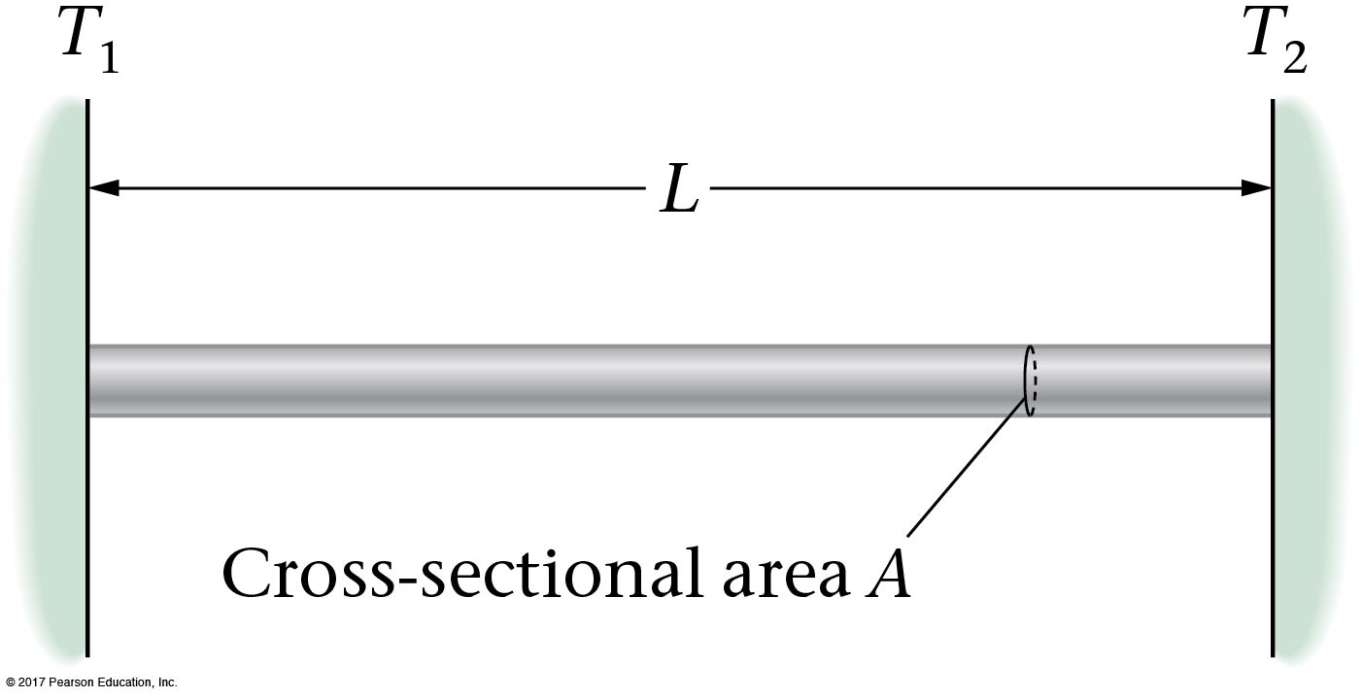
Conduction
Conduction, convection, and radiation are three ways that heat can be exchanged.
Conduction is the flow of heat directly through a physical material.

Slide 22
a-6 Conduction
Experimentally, it is found that the amount of heat Q that flows through a rod:
increases proportionally to the cross-sectional area A.
increases proportionally to the temperature difference from one end to the other.
increases steadily with time.
decreases with the length of the rod.

Slide 23
Conduction,
Combining, we find:
The constant k is called the thermal conductivity.

Slide 24
Two different rods of the same length are placed between the same temperature difference. Rod A has four times the thermal conductivity as rod B. For the two rods to have the same heat Q in the same time t, what should be the ratio of the diameter of rod B to rod A?
2
4
1/2
1/4
Heat Conduction
Notes:
Answer: A

Slide 25
Two different rods of the same length are placed between the same temperature difference. Rod A has four times the thermal conductivity as rod B. For the two rods to have the same heat Q in the same time t, what should be the ratio of the diameter of rod B to rod A ($D_{B}/D_{A}$)?
2
4
1/2
1/4
The heat flow rate is kA (T₁ − T₂)/l. The area is proportional to the diameter squared, so to get the same heat flow in each rod, the cross-sectional area of rod B must be four times the area of rod A. Therefore, its diameter needs to be double that of rod A.

Slide 26
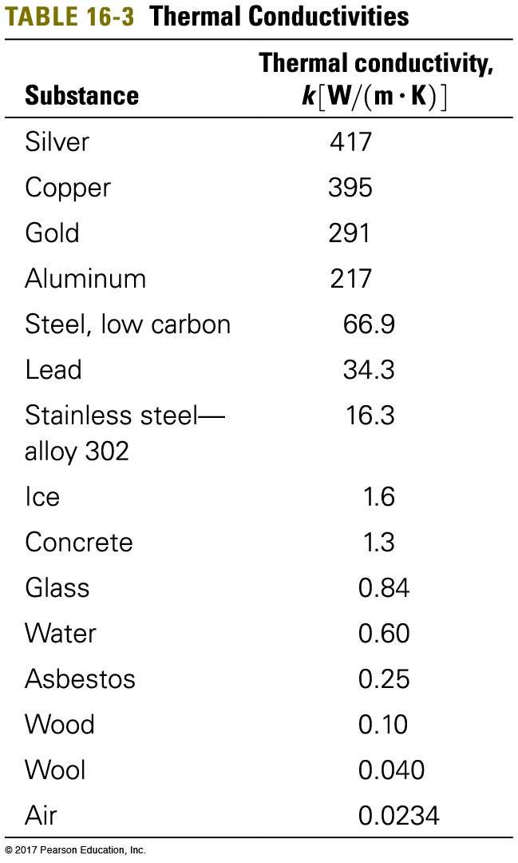
Thermal Conductivity,
Substances with high thermal conductivities are good conductors of heat; those with low thermal conductivities are good insulators.
Glass 0.84,
Air 0.023

Slide 27
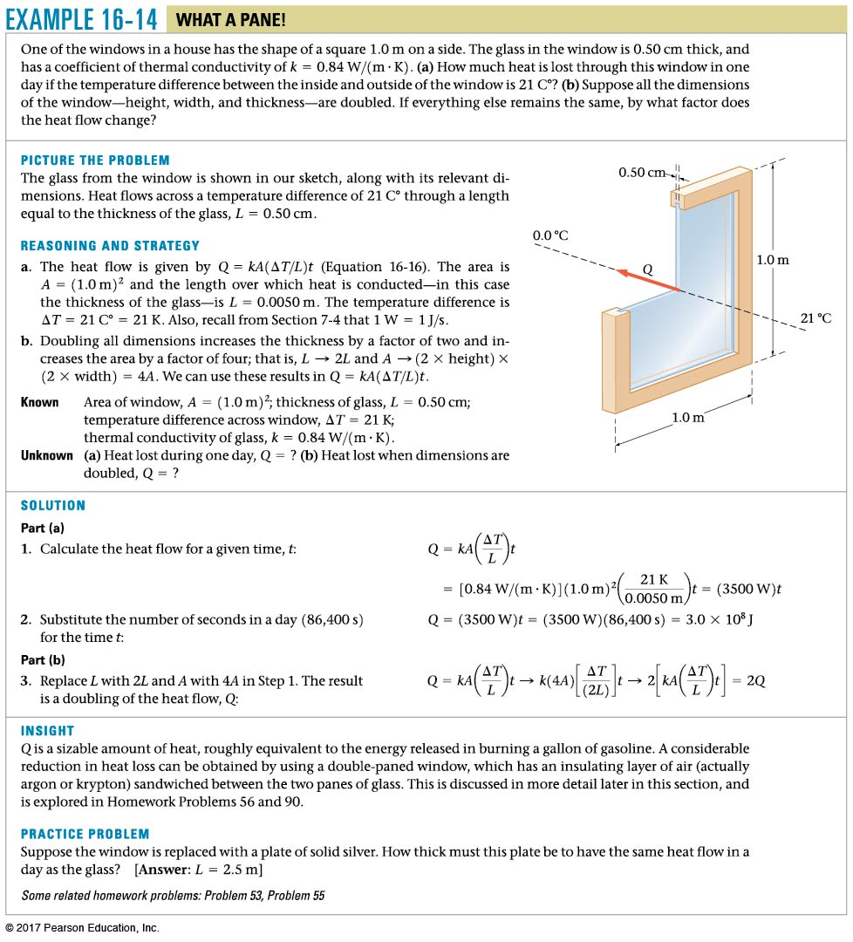
Example a.14
1 kw-hr =3.6 million J,
15 cent/kW-hr

Slide 28
Example a.a

Slide 29
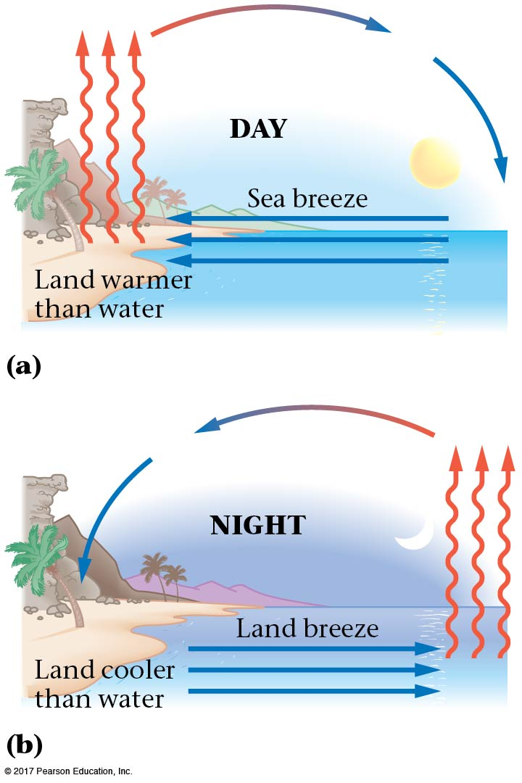
Convection
Convection is the flow of fluid due to a difference in temperatures, such as warm air rising. The fluid “carries” the heat with it as it moves.
Water have a large specific heat. Land is heated up faster during the day.
Ar night, water cools off slower

Slide 30
Convection cells
Thermal pane windows: Two glass panes separated by a distance d. If d is less than the cell size, cell cannot form and convection is stopped

Slide 31
Water has a higher specific heat than sand. Therefore, on the beach at night, breezes would blow
from the ocean to the beach.
from the beach to the ocean.
either way, makes no difference.
Night on the Beach
Notes:
Answer: B

Slide 32
Water has a higher specific heat than sand. Therefore, on the beach at night, breezes would blow
from the ocean to the beach.
from the beach to the ocean.
either way, makes no difference.
c_{sand} < c_{water}
Daytime
sun heats both the beach and the water
beach heats up faster
warmer air above beach rises
cooler air from ocean moves in underneath
breeze blows ocean → land
Nighttime
sun has gone to sleep
beach cools down faster
warmer air is now above the ocean
cooler air from beach moves out to the ocean
breeze blows land → ocean
Night on the Beach

Slide 33
Radiation
The charges in atoms are accelerated randomly and thus emit radiation. Thus all objects give off energy in the form of radiation as electromagnetic waves—infrared, visible light, ultraviolet—which, unlike conduction and convection, can transport heat through a vacuum.
Objects that are hot enough will glow—first red, then yellow, white, and blue. Objects at body temperature radiate in the infrared and can be seen with night vision binoculars.

Slide 34
Radiation
The amount of energy radiated by an object due to its temperature is proportional to its surface area and also to the fourth (!) power of its temperature.
It also depends on the emissivity, which is a number between 0 and 1 that indicates how effective a radiator the object is; a perfect radiator would have an emissivity of 1.

Slide 35
Radiation
This behavior is contained in the Stefan-Boltzmann law:
Here, e is the emissivity, and σ is the Stefan-Boltzmann constant:

Slide 36
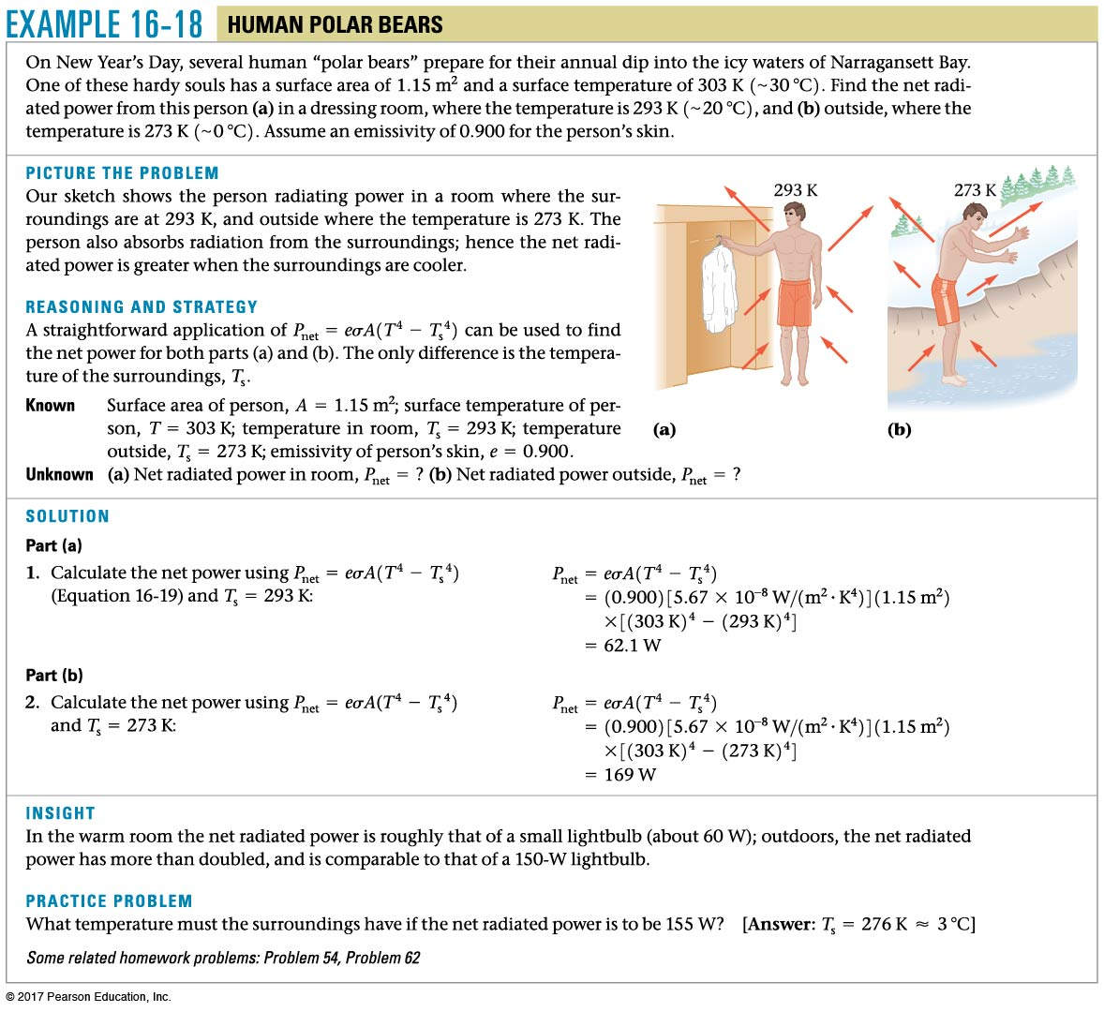
Example a.18

Slide 37
If the Sun’s surface temperature falls to half the current surface temperature, by what factor will the radiant energy reaching the Earth change?
Increase by factor of 16
Increase by factor of 4
It will remain the same
Decrease by factor of 4
Decrease by factor of 16
Radiation
Notes:
Answer: E

Slide 38
If the Sun’s surface temperature falls to half the current surface temperature, by what factor will the radiant energy reaching the Earth change?
Increase by factor of 16
Increase by factor of 4
It will remain the same
Decrease by factor of 4
Decrease by factor of 16
Radiation energy is proportional to T₄. So if temperature is halved, radiation energy will decrease by a factor of a.

Slide 39
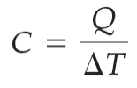
Summary of Chapter a
Heat is a form of energy:
Heat capacity of an object:
Specific heat is heat capacity per unit mass:
Energy is conserved in heat flow.

Slide 40
Summary of Chapter a
Conduction: heat exchange from one part of a material to a cooler part, with no bulk motion of the material.
Heat exchanged in time t:
Convection is heat exchange due to the bulk motion of an unevenly heated fluid.
Radiation is heat exchange due to electromagnetic radiation.

Slide 41
Summary of Chapter a
Radiated power as a function of temperature:
Stefan-Boltzmann constant:
The net radiated power to surroundings at T_{s}:

