Slide 1
Thermodynamics and statistical mechanics
Wechat id chuist66

Slide 2
A night view of Shanghai where I am.

Slide 3
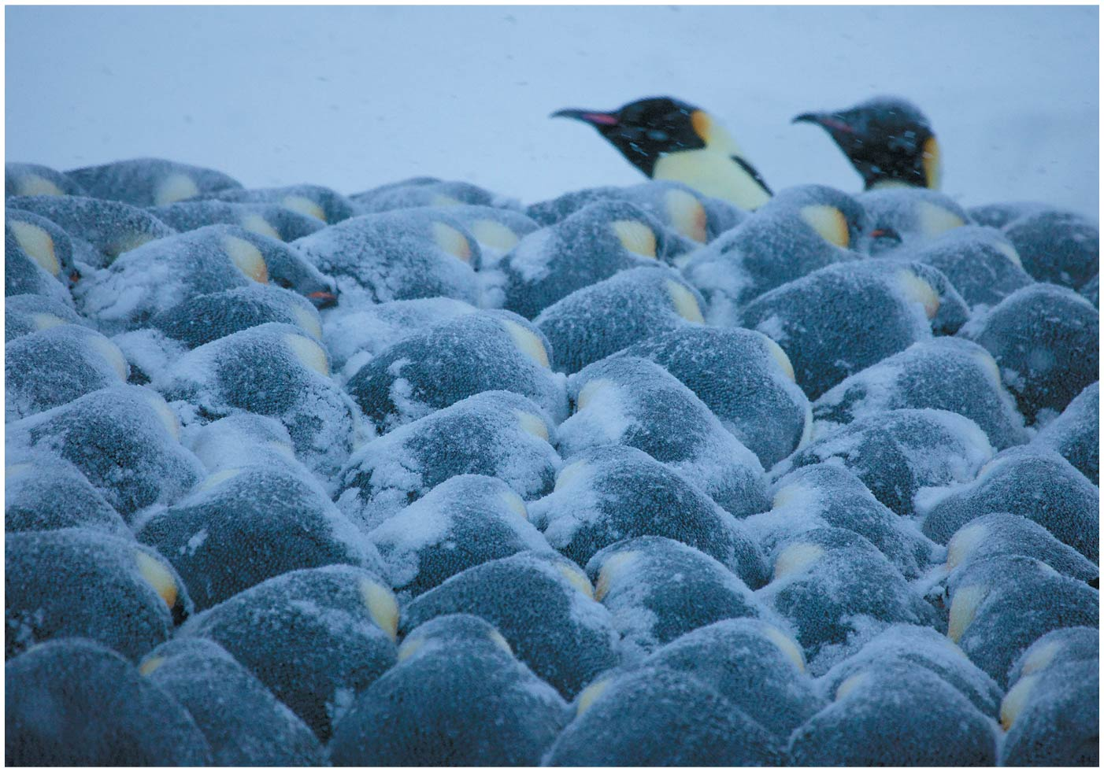
Chapter a Temperature and Heat

Slide 4
Target audience
This is an elementary course.
For beginning students who know calculus, mechanics and electricity and magnetism.

Slide 5
Interaction in class
During class, I shall ask you guys questions. Please send the answer to me via the zoom polling.
You get full mark no matter it is correct or not, so long as you send the answer.
Hopefully some of you or your friends know how to compile and run programs on computers.
Later on in the class, we can learn about computer simulation and I can give you programs to run.

Slide 6
Lectures will sometimes be easy, sometimes abstract. Please ask questions if you do not understand.
.

Slide 7
I found thermodynamics abstract and difficult to understand.
Statistical mechanics is more concrete. So in this course I usually start with statistical mechanics, then go into the related thermodynamics concepts.

Slide 8
a-1 Temperature and the Zeroth Law of Thermodynamics
Definition of heat:
Heat is the energy due to the random motion of the degrees of freedom of the atoms, it is transferred between objects with a temperature difference.
Objects are in thermal contact if heat can flow between them.
When the transfer of heat between objects in thermal contact ceases, they are in thermal equilibrium.

Slide 9
Microscopic picture: Random motion means fluctuating among different configurations . Amount of fluctuation depends on temperature Example: atomic magnetic moments in a magnet.

Slide 10
Physical property depends on the time average of the configurations of the system
Example: Fluctuating magnetic moments
Another example: many particles interacting with their motion governed by Newton’s equation. We need the averages of the configurations at different times.
Energy is conserved. So these configurations have the same energies.
Assumption : Time average = average of all configurations with the same energy.

Slide 11
Ergodic Hypothesis
For the configuration average, all possible configurations are reached.
This is not always true. An obvious counter-example is the glass where things are frozen and move too slowly. The time scale is too long.

Slide 12
What does possible configuration mean? We sum over configurations with the same conserved quantities, which sometimes include other quantity in addition to the energy.
For the configurations there are conserved quantities.
The most common example are configurations with the same energy.
There can be other conserved quantities for special situations, an example is the total angular momentum in stars.

Slide 13
The most common example: Only the energy is conserved
The collection of configurations with the same energy is called microcanonical ensemble.
The number of configurations provides the probability of finding the state with the given energy.

Slide 14
Mathematics
Mathematically, the configurations are solutions of differential equations such as the Newton equation or the Schrodinger equation.
There are different classes of solutions, periodic or chaotic. Here we focused on the chaotic solutions.
The idea of statistical mechanics can be applied to other chaotic solutions of other differential equations. For example, concepts such as temperature can be generalized to solutions of differential equations.
Possible example: a current area of interest is called system biology that predicts biological process from differential equations.

Slide 15
Temperature
Usually one is interested not in the whole universe but in a “subsystem” with energy $E_{s}$and coordinates {x} that can exchange energy with another system with energy $E_{B}$ and coordinates {y} so that the total energy $E_{s}\left(x)+E_{B}(y\right)=E_{0}$ is fixed. Systems that can only exchange energy are called canonical ensemble
The two systems achieve equilibrium states that is the most likely and maximize the total number of configurations.
We show below that one can define a quantity called the temperature and the condition that the system are in equilibrium corresponds to the condition that the temperatures of the two systems are equal.

Slide 16
What is “Temperature”?
The two system that are in thermal contact achieve an equilibrium states that is the most likely and maximize the total number of configurations.
We define a quantity S so that $e^{S{(E′}_{})}=\int{d\{y\}δ[E_{S}−E′]}$ is the total number of configurations for a system S with energy E’.
The reason we define S as an exponent is that then it will be proportional to the number of particles:The number of configurations for N particles in volume V is of the order $V^{N}=e^{N\ln{V}}$.
Quantities that are (not) proportional to the number of particles are called extensive (intensive). S is thus extensive.

Slide 17
What is “Temperature”?
The two system with the total energy $E_{s}\left(x)+E_{B}(y\right)=E_{0}$that are in thermal contact achieve an equilibrium state that is the most likely and maximize the total number of configurations.
$e^{S{(E′}_{})}=\int{d\{y\}δ[E_{S}−E′]}$ is the total number of configurations for a system S with energy E’.
The total configuration of the two systems is ${N=e}^{Ss{(E}_{s})}e^{Sb{(E}_{B})}$=$e^{Ss{(E}_{s})}e^{Sb{(E−E}_{S})}$
The maximum configuration condition implies that the derivative of N with respect to E is zero.
We define the temperature by ${1/(k}_{B}T)=\frac{dS{(E}_{})}{dE}$. The scale of T is set by $k_{B},$called the Boltzmann’s constant.
$dN=NdE_{s}\left(\frac{1}{\text{Ts}}−\frac{1}{\text{T}B}\right)/k_{B}=0$means Ts=Tb.

Slide 18
Approach to equilibrium, ${1/(k}_{B}T)=\frac{dS{(E}_{})}{dE}$
If $T_{s}≠T_{B}$, the number of configurations is not at a maximum and the system will move to a new state with larger number of configurations.
$dN=NdE_{s}\left(\frac{1}{\text{Ts}}−\frac{1}{\text{T}B}\right)$/$k_{B}$>0
Sign of $dE_{s}$ is the opposite that of $T_{s}−T_{B}.$ If $T_{s}$ is larger , its energy ($dE_{s}$) is decreased and heat will flow away from it .

Slide 19
a-1 Temperature and the Zeroth Law of Thermodynamics
The zeroth law of thermodynamics:
If object A is in thermal equilibrium with object B, and object C is also in thermal equilibrium with object B, then objects A and C will be in thermal equilibrium if brought into thermal contact.
The objects are in thermal equilibrium if they have the same temperature.
Temperature is the only factor that determines whether two objects in thermal contact are in thermal equilibrium or not.

Slide 20
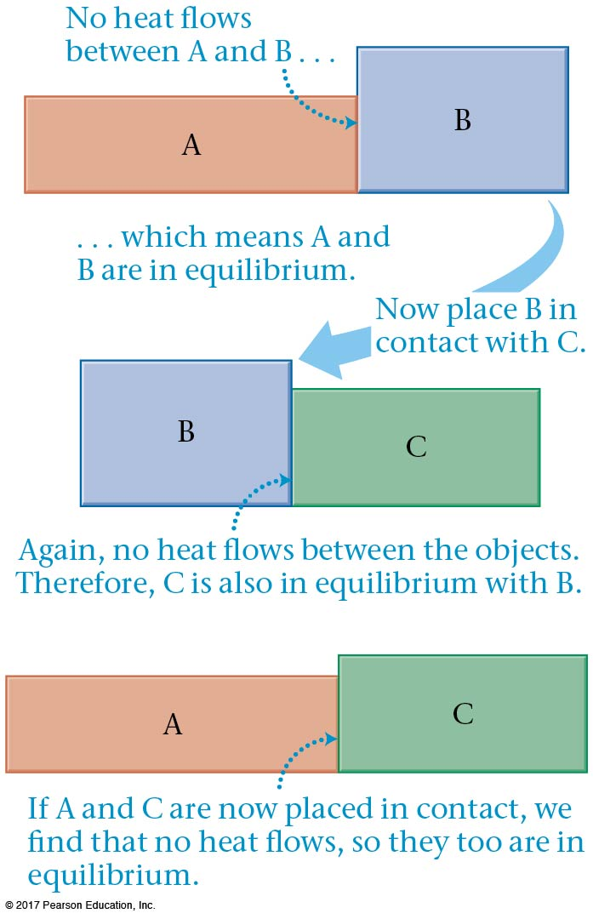
a-1 Temperature and the Zeroth Law of Thermodynamics (trivial in terms of temperature)

Slide 21
Summary: S(E)=ln( number of configurations with energy E.
${1/(k}_{B}T)=\frac{∂S{(E}_{})}{∂E}$.
When two systems are in equilibrium the temperatures of the two systems are equal.

Slide 22
T$\text{he} \text{Boltzman} \text{canonical} \text{distribution}$ A system is in contact with its environment at a temperature T. The average of physical properties also depends on the number of configurations of the environment.
The average of a physical quantity Q is given by (Angular bracket means an average.)
$<Q> ∝\int{d\{x\}e^{S{(E}_{0}−E_{S})}Q\left(\{x\}\right)}$ where we integrate over configurations {x} with the same energy $E_{S}$
$S{(E}_{0}−E_{S})≅S{(E}_{0})−E_{S}/k_{B}T$ where ${1/(k}_{B}T)=\frac{∂S{(E}_{0})}{∂E}.$
We finally obtain $<Q> =\frac{\int{d\{x\}Q\left(\{x\}\right)P′\left(\{x\}\right)}}{\int{d\{x\}P′\left(\{x\}\right)}};$
$P′$=$e^{−E_{S}/k_{B}T}$
The denominator is the normalization so that the total probability is 1.

Slide 23
T$\text{he} \text{Boltzman} \text{canonical} \text{distribution}$ The average of physical properties also depends on the number of configurations of the environment.
$<Q> ∝\int{d\{x\}e^{S{(E}_{0}−E_{S})}Q\left(\{x\}\right)}$
$S{(E}_{0}−E_{S})≅S{(E}_{0})−E_{S}/k_{B}T$ where ${1/(k}_{B}T)=\frac{∂S{(E}_{0})}{∂E}.$
We finally obtain $<Q> =\frac{\int{d\{x\}Q\left(\{x\}\right)P′\left(\{x\}\right)}}{\int{d\{x\}P′\left(\{x\}\right)}};$
$P′$=$e^{−E_{S}/k_{B}T}$
Implicit in this is the assumption that the temperature of the environment is constant and we do not need to worry about its change with the energy of the system, which is much smaller ${(E}_{0}≫E_{S}$).

Slide 24
Classical vs Quantum mechanics
The Boltzmann distribution is applicable to both classical and quantum mechanics.
For quantum mechanics, P is called the density matrix, E is replaced by an equivalent operator called the Hamiltonian. There are many stationary configurations of the system, with different energies $e_{i}$. We get
$<Q> =\sum_{i}{<i\left|Q\right|i>e^{−e_{i}/k_{B}T}}/\sum_{i}{e^{−e_{i}/k_{B}T}}$

Slide 25
a-2 Temperature Scales
The Celsius scale:
Water freezes at 0º Celsius.
Water boils at 100º Celsius.
The Fahrenheit scale:
Water freezes at 32º Fahrenheit.
Water boils at 212º Fahrenheit.

Slide 26
a-2 Temperature Scales
Converting between Celsius and Fahrenheit:
Converting between Fahrenheit and Celsius:

Slide 27
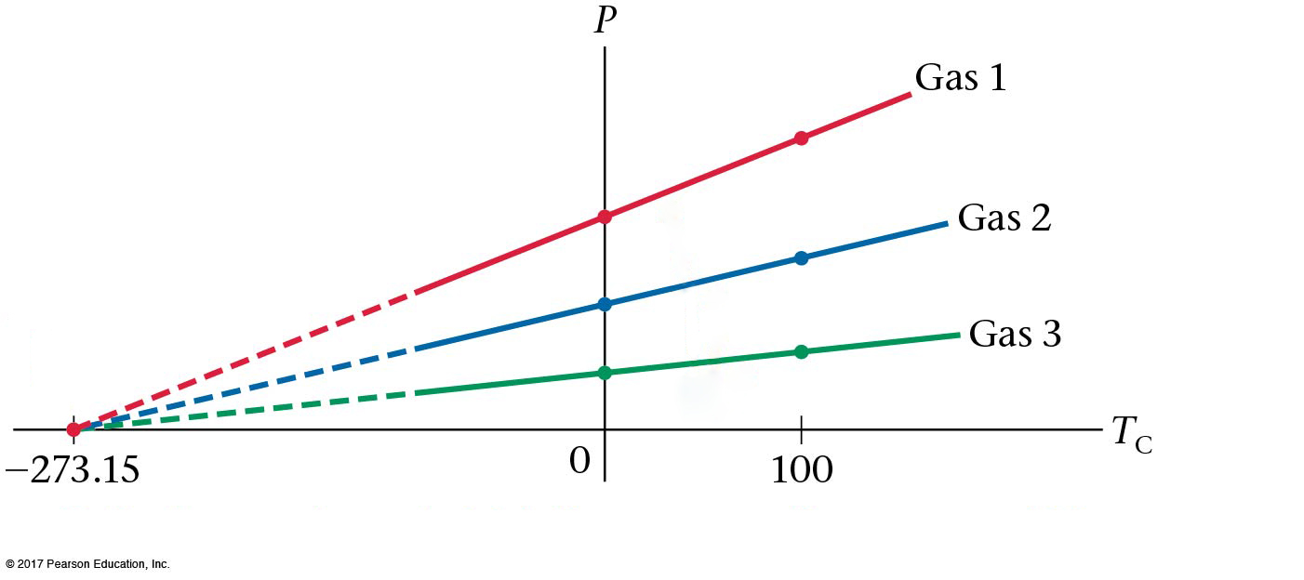
a-2 Temperature Scales
The pressure in an very dilute (ideal) gas is proportional to its temperature. The proportionality constant is different for different gases, but they all reach zero pressure at the same temperature, which we call absolute zero:

Slide 28
Example a.3

Slide 29
a-2 Temperature Scales
The Kelvin scale is similar to the Celsius scale, except that the Kelvin scale has its zero at absolute zero.
Conversion between a Celsius temperature and a Kelvin temperature:

Slide 30
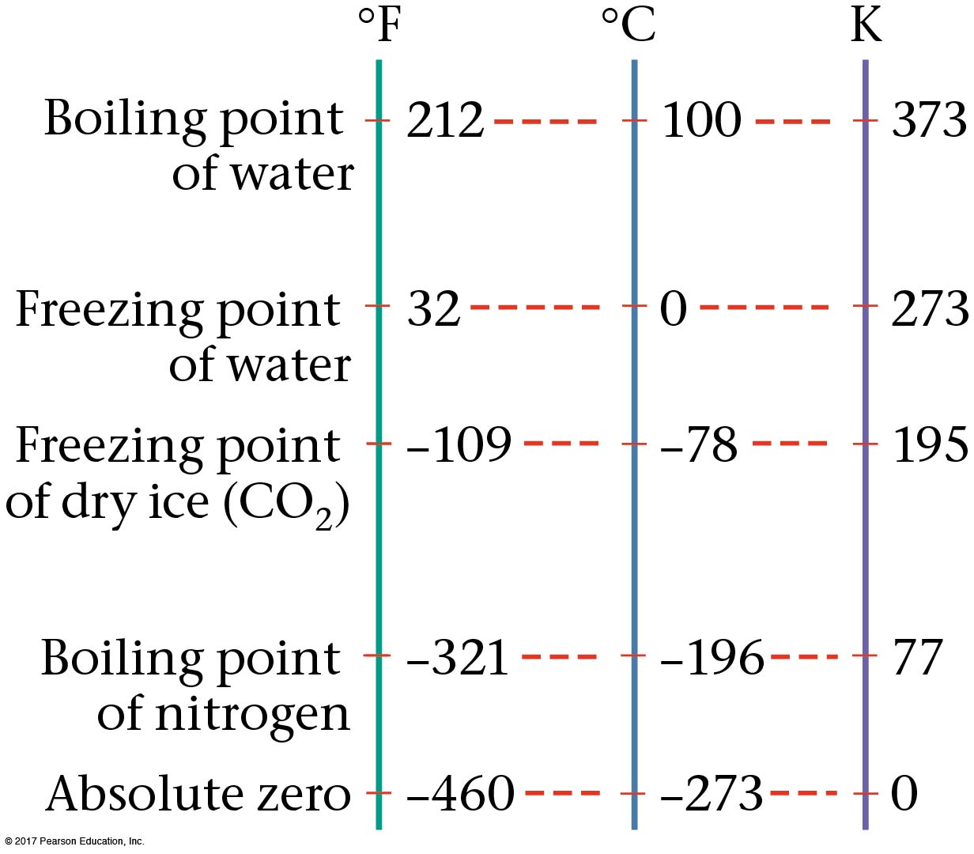
a-2 Temperature Scales
The three temperature scales compared:

Slide 31
Which is the largest unit: one Celsius degree, one Kelvin degree, or one Fahrenheit degree?
One Celsius degree
One Kelvin degree
One Fahrenheit degree
Both one Celsius degree and one Kelvin degree
Both one Fahrenheit degree and one Celsius degree
Degrees
Notes:
Answer: D

Slide 32
Which is the largest unit: one Celsius degree, one Kelvin degree, or one Fahrenheit degree?
One Celsius degree
One Kelvin degree
One Fahrenheit degree
Both one Celsius degree and one Kelvin degree
Both one Fahrenheit degree and one Celsius degree
The Celsius degree and the Kelvin degree are the same size. The scales only differ by an offset, not by the size of the degree unit. For Fahrenheit, there are 180 degrees between boiling and freezing (212ºF–32ºF). For Celsius, there are 100 degrees between the same points, so the Celsius (and Kelvin) degrees must be larger.

Slide 33
a-3 Thermal Expansion
Most substances expand when heated; the change in length or volume is typically proportional to the change in temperature.
:

Slide 34
Concept Example a.5

Slide 35
a-3 Thermal Expansion
Most substances expand when heated; the change in length or volume is typically proportional to the change in temperature.
The expansion is also proportional to the original size.
The proportionality constant is called the coefficient of linear expansion:

Slide 36
a-3 Thermal Expansion
Some typical coefficients of thermal expansion (high speed rail?):

Slide 37
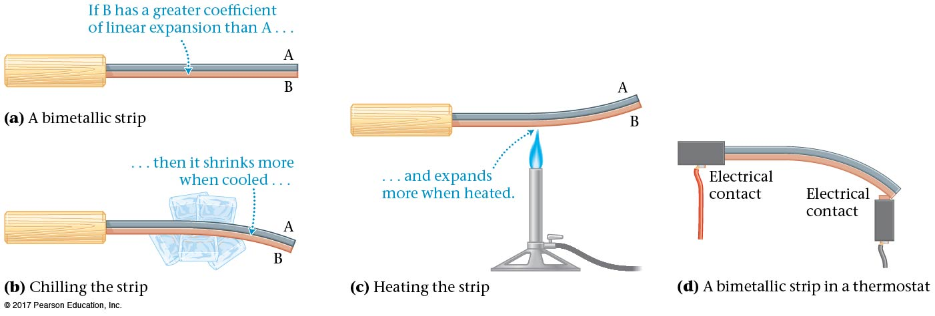
a-3 Thermal Expansion
A bimetallic strip consists of two metals of different coefficients of thermal expansion, A and B in the figure. It will bend when heated or cooled.

Slide 38
A steel tape measure is marked such that it gives accurate length measurements at room temperature. If the tape measure is used outside on a very hot day, how will its length measurements be affected?
Measured lengths will be too small
Measured lengths will still be accurate
Measured lengths will be too big
Steel Expansion
Notes:
Answer: A

Slide 39
A steel tape measure is marked such that it gives accurate length measurements at room temperature. If the tape measure is used outside on a very hot day, how will its length measurements be affected?
Measured lengths will be too small
Measured lengths will still be accurate
Measured lengths will be too big
The tape measure will expand, so its markings will spread out farther than the correct amount. When it is laid down next to an object of fixed length, you will read too few markings for that given length, so the measured length will be too small.
Steel Expansion

Slide 40
A grandfather clock uses a brass pendulum to keep perfect time at room temperature. If the air conditioning breaks down on a very hot summer day, how will the grandfather clock be affected?
Clock will run slower than usual
Clock will still keep perfect time
Clock will run faster than usual
Grandfather Clock
Notes:
Answer: A

Slide 41
A grandfather clock uses a brass pendulum to keep perfect time at room temperature. If the air conditioning breaks down on a very hot summer day, how will the grandfather clock be affected?
Clock will run slower than usual
Clock will still keep perfect time
Clock will run faster than usual
The pendulum will expand, so its length will increase. The period of a pendulum depends on the length, as shown below, so the period will also increase. Thus, the clock will run slow.
$$T=2π\sqrt{\frac{L}{g}}$$
Follow-up: Roughly how much slower will it run?
Grandfather Clock

Slide 42
a-3 Area Thermal Expansion
The expansion of an area of a flat substance is derived from the linear expansion in both directions:
$A^{′}=(L+∆L)^{2}=L^{2}+2L∆L+{∆L}^{2}≈L^{2}+2L∆L$
$∆A=A^{′}−L^{2}≈2L∆L$
$∆A/A≈2∆L/L$

Slide 43
a-3 Area Thermal Expansion
Holes expand as well:

Slide 44
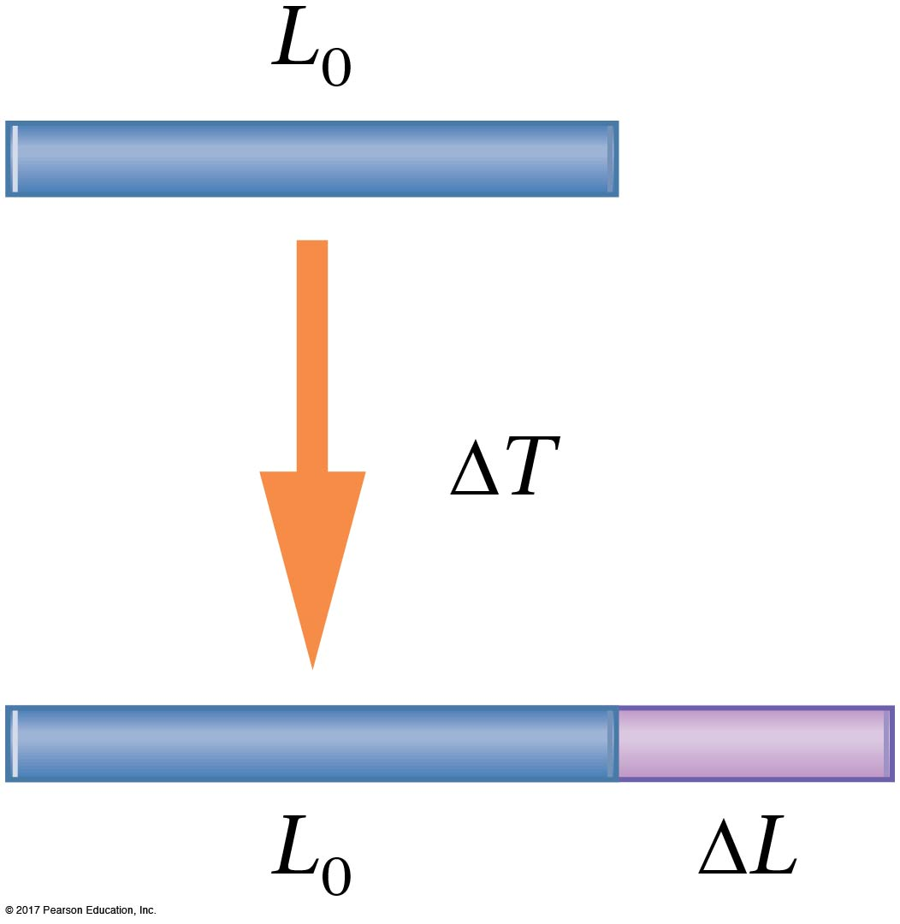
Holes

Slide 45
A steel ring stands on edge with a rod of unknown material inside. As this system is heated, for which of the following rod materials will the rod eventually touch the top of the ring?
Quartz
Glass
Steel
Al
Hg
Air
Aluminum
Steel
Glass
Aluminum and steel
All three
10^{–6}
10^{–5}
10^{–4}
10^{–3}
Coefficient of volume expansion β (1/ºC)
Steel Ring
Notes:
Answer: A

Slide 46
A steel ring stands on edge with a rod of unknown material inside. As this system is heated, for which of the following rod materials will the rod eventually touch the top of the ring?
Aluminum
Steel
Glass
All three
Quartz
Glass
Steel
Al
Hg
Air
10^{–6}
10^{–5}
10^{–4}
10^{–3}
Coefficient of volume expansion β (1/ºC)
Aluminum is the only material that has a larger β value than the steel ring, so that means that the aluminum rod will expand more than the steel ring. Thus, only in that case does the rod have a chance of reaching the top of the steel ring.
Steel Ring

Slide 47
a-3 Volume Thermal Expansion
The change in volume of a solid is also derived from the linear expansion:
$V^{′}=(L+∆L)^{3}=L^{3}+3L^{2}∆L+{3L∆L}^{2}+{∆L}^{3}≈L^{3}+3L^{2}∆L$
$∆V=V^{′}−L^{3}≈3L^{2}∆L$
$∆V/V≈3∆L/L$

Slide 48
a-3 Thermal Expansion
The change in volume of a solid is also derived from the linear expansion:
For liquids and gases, only the coefficient of volume expansion is defined:

Slide 49
a-3 Thermal Expansion
Some typical coefficients of volume expansion:

Slide 50
Example a.8

Slide 51
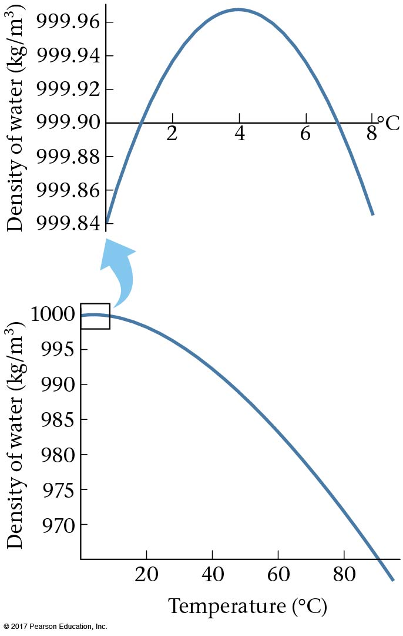
a-3 Thermal Expansion
Water also expands when it is heated, except when it is close to freezing; it actually expands when cooling from 4ºC to 0ºC. This is why ice floats and frozen bottles burst.

