Slide 1
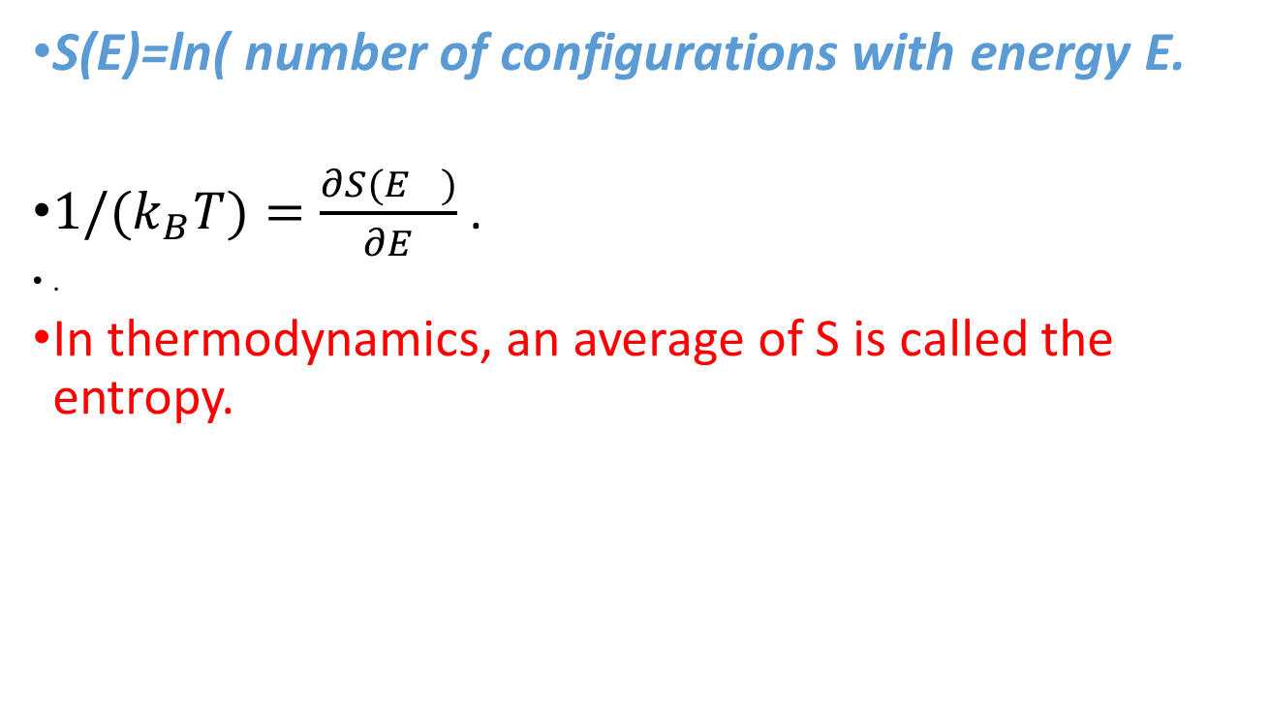
Recapitulation
S(E)=ln( number of configurations with energy E.
${1/(k}_{B}T)=\frac{∂S{(E}_{})}{∂E}$.
.
In thermodynamics, an average of S is called the entropy.

Slide 2

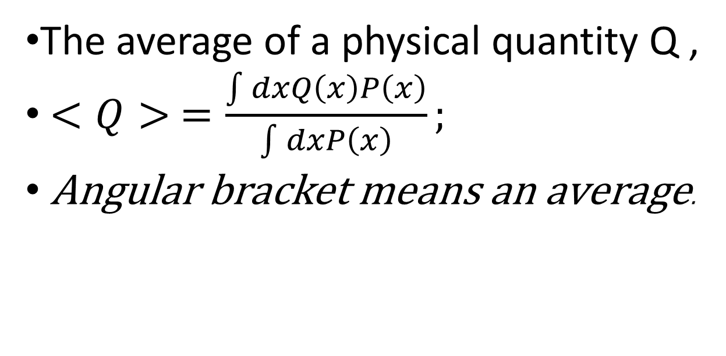
Recapitulation:
T$\text{he} \text{Boltzman} \text{canonical} \text{distribution}$:
$P$=$e^{−E_{S}/k_{B}T}$
The average of a physical quantity Q ,
$<Q> =\frac{\int{dxQ\left(x\right)P\left(x\right)}}{\int{dxP\left(x\right)}};$
Angular bracket means an average.

Slide 3
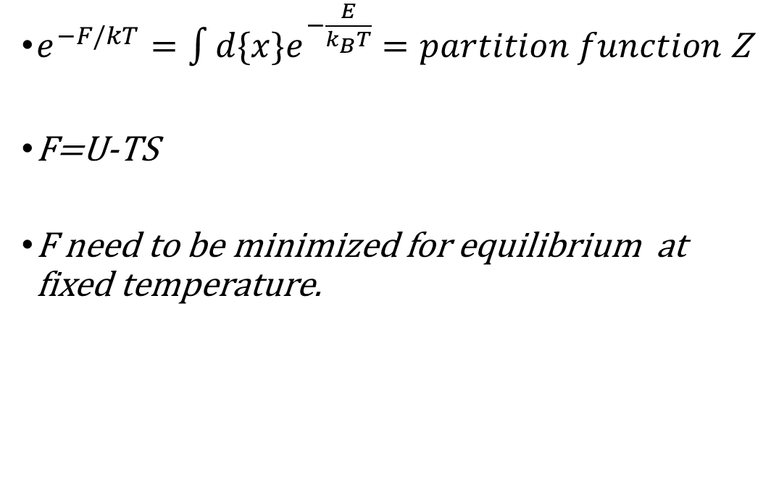
Recapitulation: Free energy F
$e^{−F/kT}=\int{d\{x\}e^{−\frac{E}{k_{B}T}}}=partition function$ Z
F=U-TS
F need to be minimized for equilibrium at fixed temperature.

Slide 4
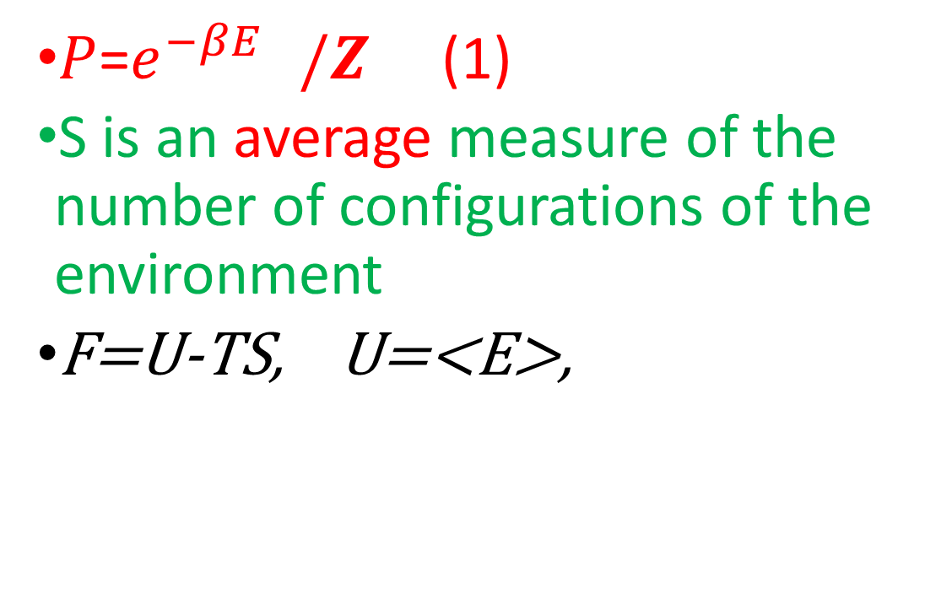
Entropy S=-k <ln P>,
$P$=$e^{−{βE}_{}}/Z$ (1)
S is an average measure of the number of configurations of the environment
F=U-TS, U=<E>,

Slide 5

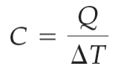

Summary of Chapter a
Heat is a form of energy:
Heat capacity of an object:
Specific heat is heat capacity per unit mass:
Energy is conserved in heat flow.

Slide 6
Heat transport
Conduction, Convection, and Radiation

Slide 7

Conduction: heat exchange from one part of a material to a cooler part, with no bulk motion of the material.
Heat exchanged in time t:
Convection is heat exchange due to the bulk motion of an unevenly heated fluid.
Radiation is heat exchange due to electromagnetic radiation.

Slide 8
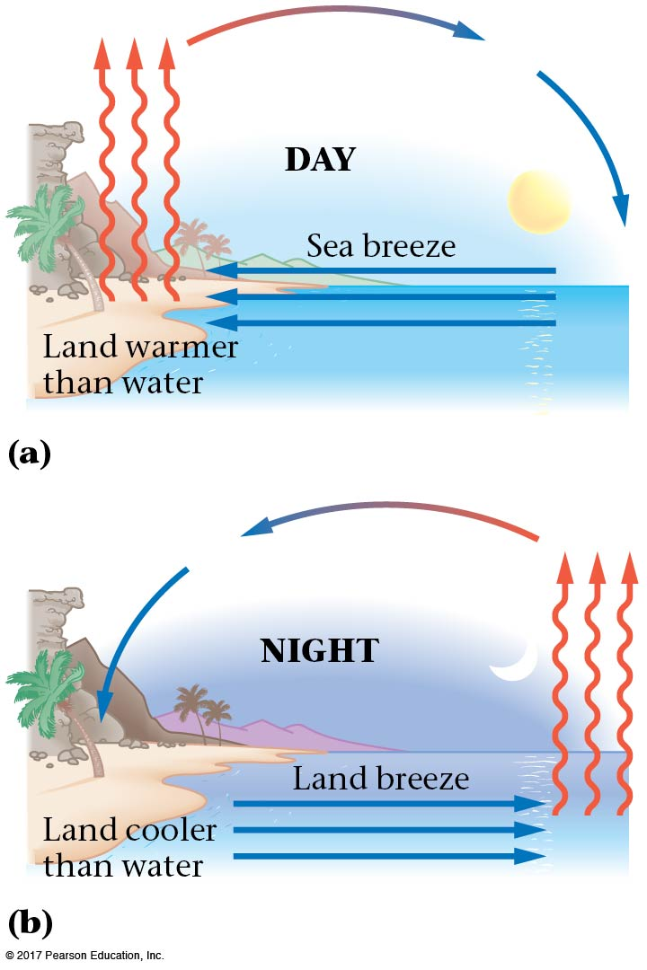
Convection
Convection is the flow of fluid due to a difference in temperatures, such as warm air rising. The fluid “carries” the heat with it as it moves.
Water have a large specific heat. Land is heated up faster during the day.
Ar night, water cools off slower

Slide 9
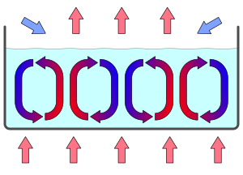
Convection cells: Fluid moves like a vortex (cells) with its size determined by the temperature difference
Thermal pane windows: Two glass panes separated by a distance d. If d is less than the cell size, cell cannot form and convection is stopped

Slide 10
Water has a higher specific heat than sand. Therefore, on the beach at night, breezes would blow
from the ocean to the beach.
from the beach to the ocean.
either way, makes no difference.
Night on the Beach
Notes:
Answer: B

Slide 11
Water has a higher specific heat than sand. Therefore, on the beach at night, breezes would blow
from the ocean to the beach.
from the beach to the ocean.
either way, makes no difference.
c_{sand} < c_{water}
Daytime
  sun heats both the beach and the water
    beach heats up faster
    warmer air above beach rises
    cooler air from ocean moves in underneath
    breeze blows ocean → land
Nighttime
  sun has gone to sleep
    beach cools down faster
    warmer air is now above the ocean
    cooler air from beach moves out to the ocean
    breeze blows land → ocean
Night on the Beach

Slide 12
Radiation
The charges in atoms are accelerated randomly and thus emit radiation. Thus all objects give off energy in the form of radiation as electromagnetic waves—infrared, visible light, ultraviolet—which, unlike conduction and convection, can transport heat through a vacuum.
Objects that are hot enough will glow—first red, then yellow, white, and blue. Objects at body temperature radiate in the infrared and can be seen with night vision binoculars.

Slide 13
Radiation
The amount of energy radiated by an object due to its temperature is proportional to its surface area and also to the fourth (!) power of its temperature.
It also depends on the emissivity, which is a number between 0 and 1 that indicates how effective a radiator the object is; a perfect radiator would have an emissivity of 1.

Slide 14
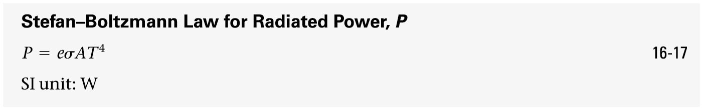

Radiation
This behavior is contained in the Stefan-Boltzmann law:
Here, e is the emissivity, and σ is the Stefan-Boltzmann constant:

Slide 15
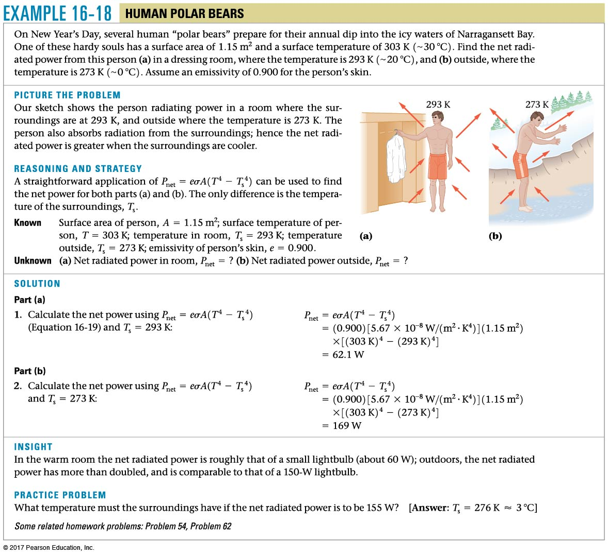
Example a.18

Slide 16
If the Sun’s surface temperature falls to half the current surface temperature, by what factor will the radiant energy reaching the Earth change?
(a) Increase by factor of 16
(b) Increase by factor of 4
(c) It will remain the same
(d) Decrease by factor of 4
(e) Decrease by factor of 16
Radiation
Notes:
Answer: E

Slide 17
If the Sun’s surface temperature falls to half the current surface temperature, by what factor will the radiant energy reaching the Earth change?
Increase by factor of 16
Increase by factor of 4
It will remain the same
Decrease by factor of 4
Decrease by factor of 16
Radiation energy is proportional to T₄. So if temperature is halved, radiation energy will decrease by a factor of a.

Slide 18
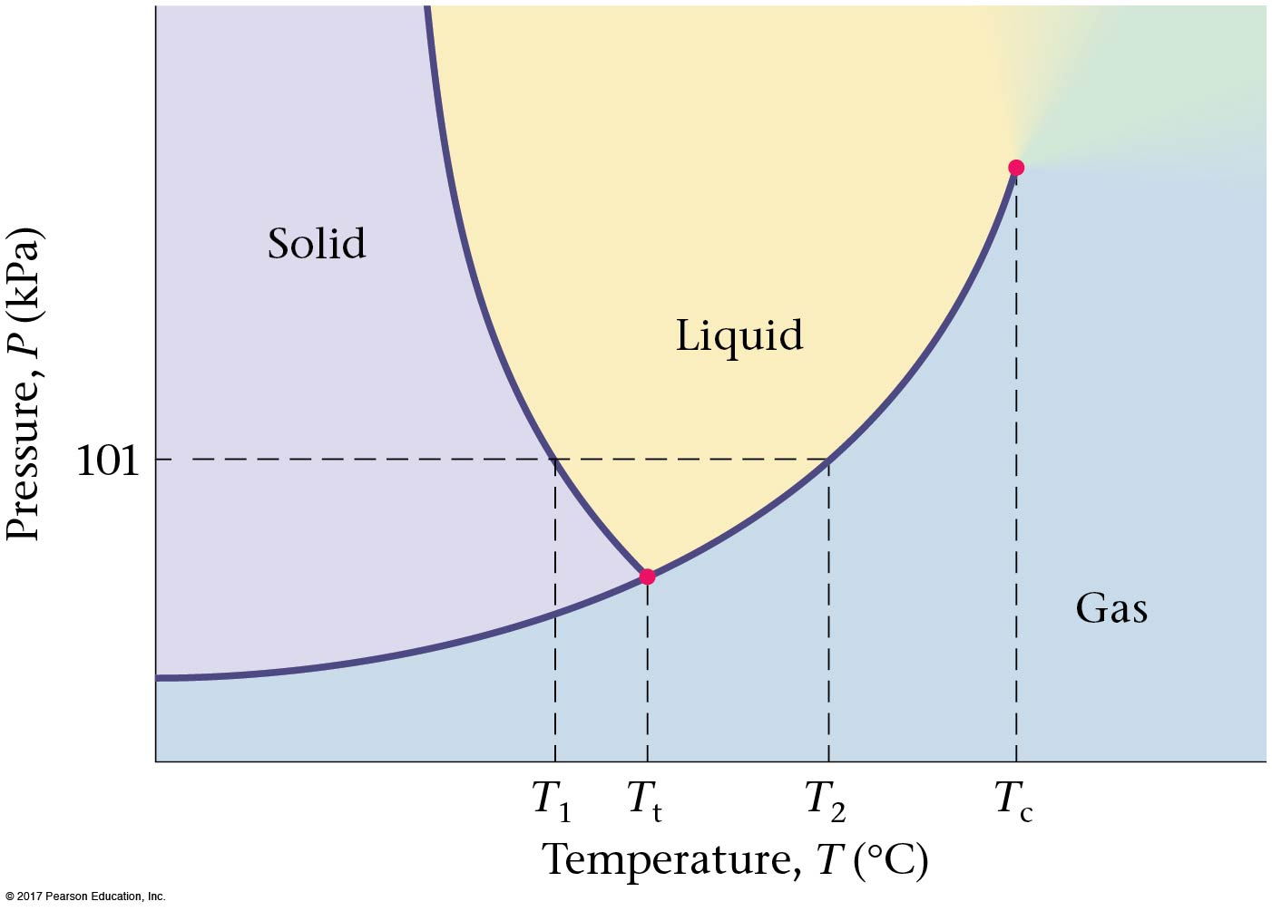
Chapter b
Phases and Phase Changes

Slide 19
Phases of matter
Gas, Liquid
Solid

Slide 20
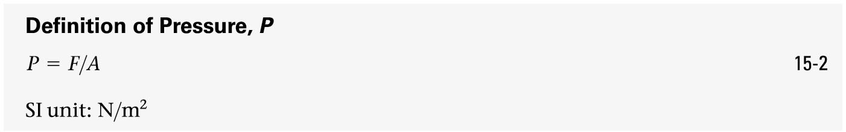
Quick introduction to the concept of Pressure
Pressure is force per unit area:

Slide 21
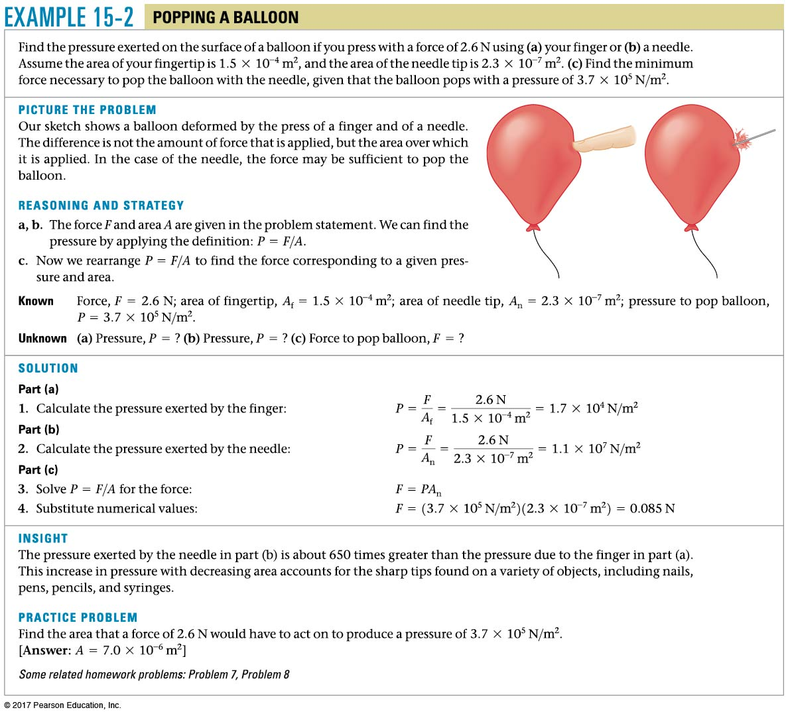
Pressure
The same force applied over a smaller area results in greater pressure—think of poking a balloon with your finger and then with a needle.

Slide 22
Example 15.2

Slide 23
Consider what happens when you push both a pin and the blunt end of a pen against your skin with the same force. What will determine whether your skin will be punctured?
(a) The pressure on your skin
(b) The net applied force on your skin
(c) Both pressure and net applied force are equivalent
(d) Neither pressure nor net applied force are relevant here.
Too Much Pressure
Notes:
Answer: A

Slide 24
Consider what happens when you push both a pin and the blunt end of a pen against your skin with the same force. What will determine whether your skin will be punctured?
The pressure on your skin
The net applied force on your skin
Both pressure and net applied force are equivalent
Neither pressure nor net applied force are relevant here.
The net force is the same in both cases. However, in the case of the pin, that force is concentrated over a much smaller area of contact with the skin, such that the pressure is much greater. Because the force per unit area
(i.e., pressure) is greater, the pin is more likely to puncture the skin.
Too Much Pressure

Slide 25
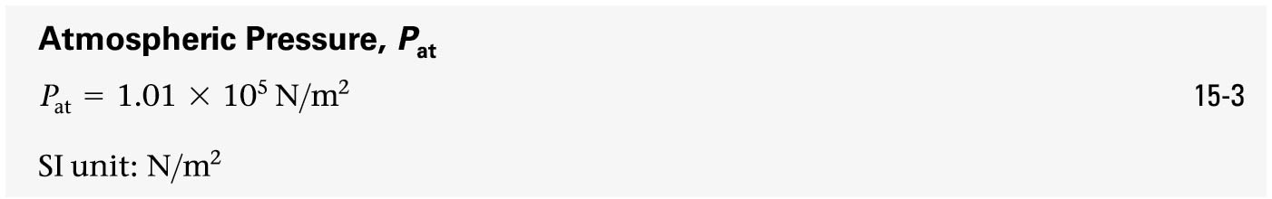
Quick introduction to the concept of Pressure
Atmospheric pressure is due to the weight of the atmosphere above us:
The pascal (Pa) is 1 N/m². Pressure is often measured in pascals.

Slide 26



Pressure
There are a number of different ways to describe atmospheric pressure.
In pascals:
In pounds per square inch:
In bars:

Slide 27
You are walking out on a frozen lake and you begin to hear the ice cracking beneath you. What is your best strategy for getting off the ice safely?
(a) Stand absolutely still and don’t move a muscle
(b) Jump up and down to lessen your contact time with the ice
(c) Try to leap in one bound to the bank of the lake
(d) Shuffle your feet (without lifting them) to move toward shore
(e) Lie down flat on the ice and crawl toward shore
On a Frozen Lake
Notes:
Answer: E

Slide 28
You are walking out on a frozen lake and you begin to hear the ice cracking beneath you. What is your best strategy for getting off the ice safely?
Stand absolutely still and don’t move a muscle
Jump up and down to lessen your contact time with the ice
Try to leap in one bound to the bank of the lake
Shuffle your feet (without lifting them) to move toward shore
Lie down flat on the ice and crawl toward shore
As long as you are on the ice, your weight is pushing down. What is important is not the net force on the ice, but the force exerted on a given small area of ice (i.e., the pressure!). By lying down flat, you distribute your weight over the widest possible area, thus reducing the force per unit area.
On a Frozen Lake

Slide 29

Pressure
Since atmospheric pressure acts uniformly in all directions, we don’t usually notice it.
Therefore, if you want to, say, add air to your tires to the manufacturer’s specification, you are not interested in the total pressure. What you are interested in is the gauge pressure—how much more pressure is there in the tire than in the atmosphere?

Slide 30
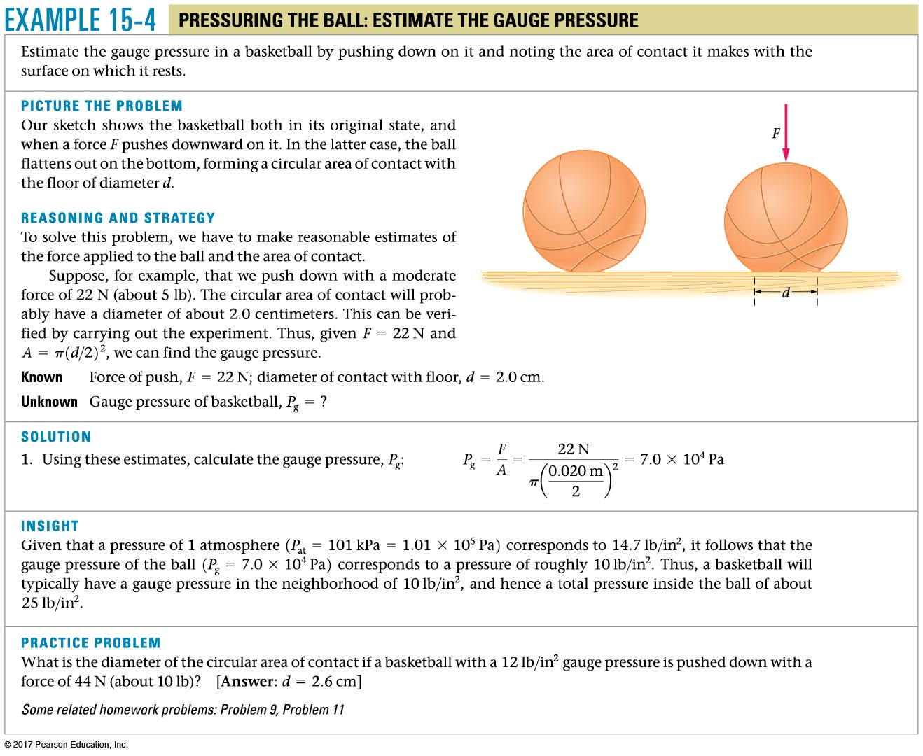
Example 15.4

Slide 31
Work = -Fdx
= -(F/A) Adx
= -PdV
Sign: when dV is negative work has been done on the system and its energy increases.

Slide 32
Now main topic: Ideal gas

Slide 33
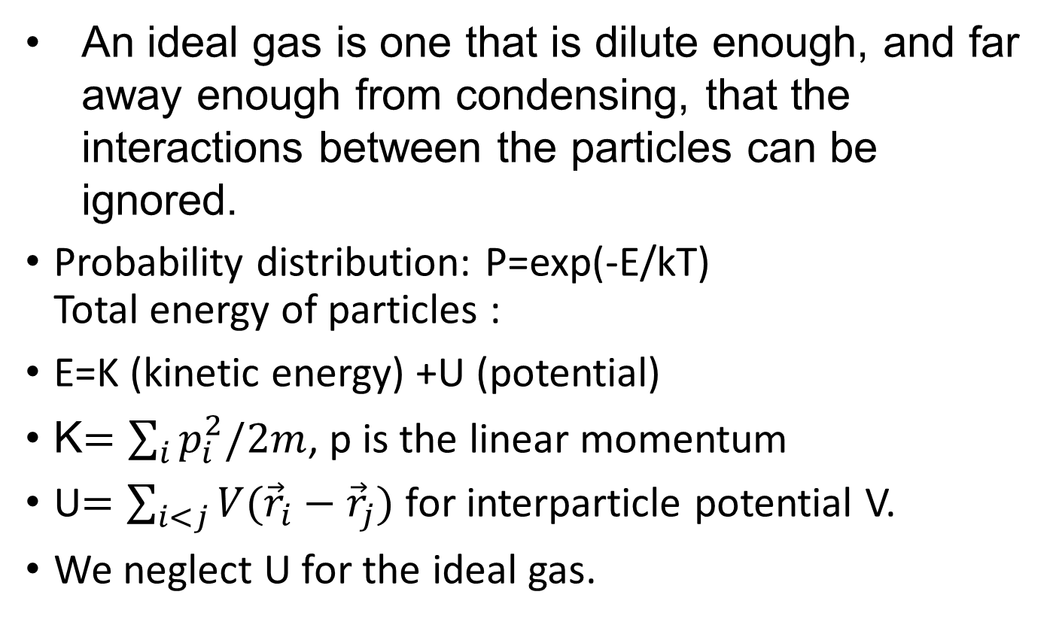
b-1 Ideal Gases
An ideal gas is one that is dilute enough, and far away enough from condensing, that the interactions between the particles can be ignored.
Probability distribution: P=exp(-E/kT)
Total energy of particles :
E=K (kinetic energy) +U (potential)
K$=\sum_{i}{p_{i}^{2}/2m}$, p is the linear momentum
U$=\sum_{i<j}{V({\vec{r}}_{i}−{\vec{r}}_{j})}$ for interparticle potential V.
We neglect U for the ideal gas.

Slide 34
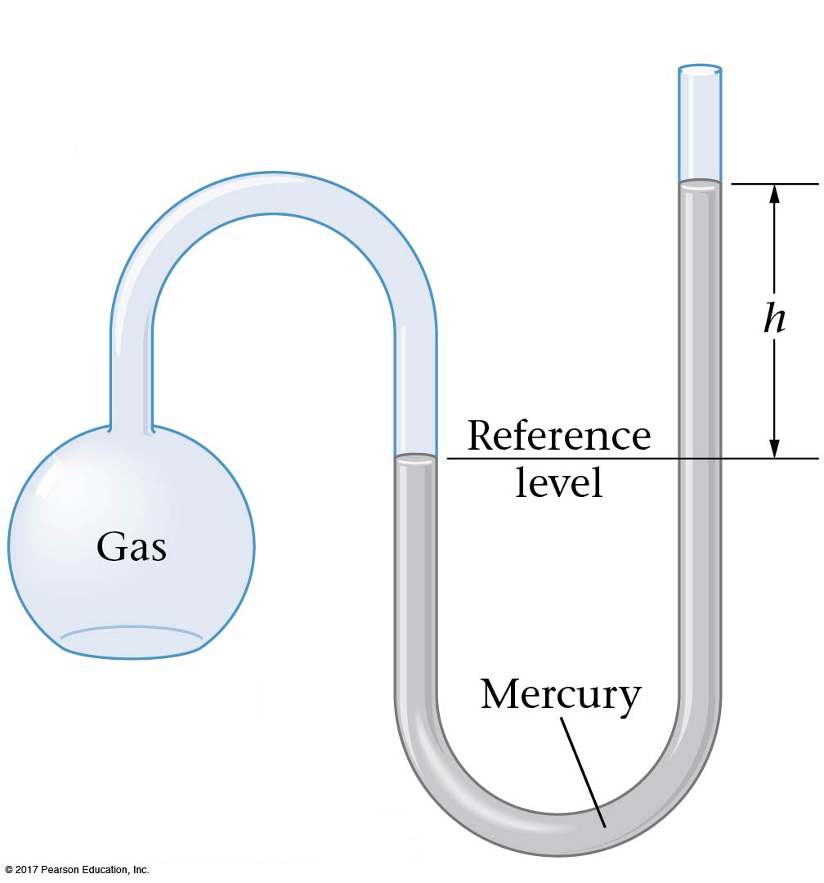
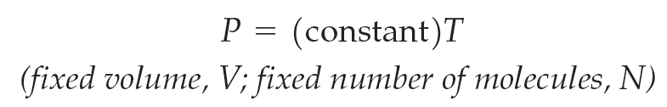
b-1 Ideal Gases
If the volume of an ideal gas is held constant, it was found that the pressure increases with temperature:

Slide 35
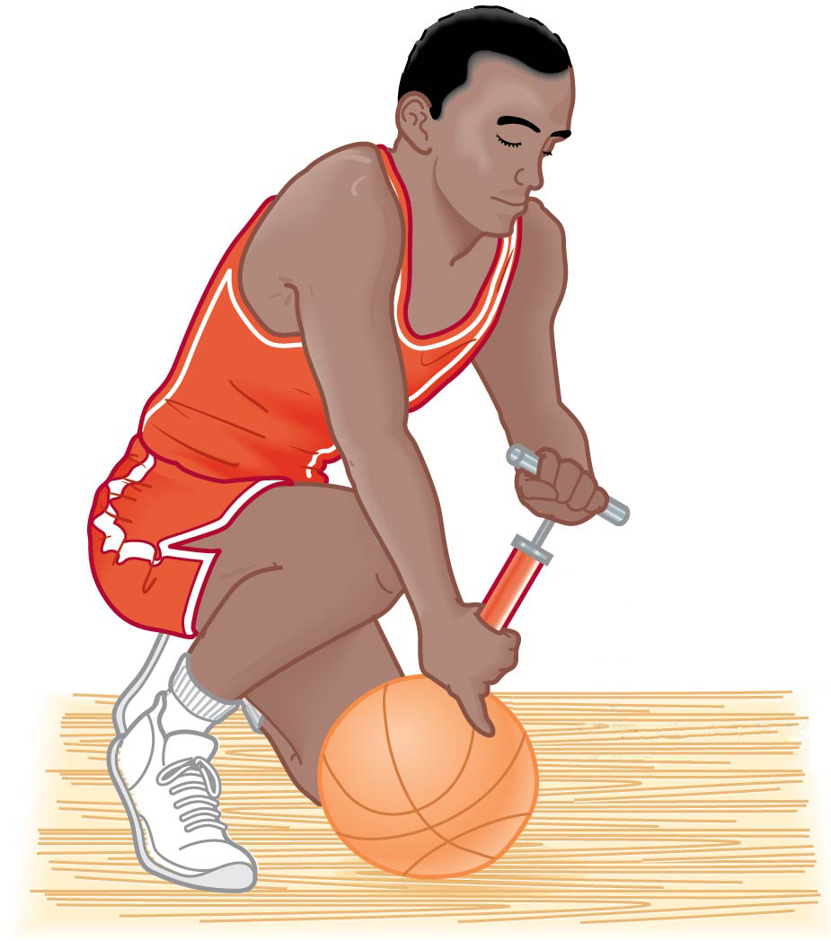
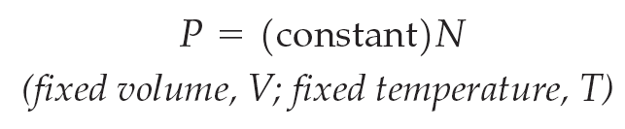
b-1 Ideal Gases
If the volume and temperature are kept constant, but more gas is added (such as in inflating a tire or basketball), the pressure will increase:

Slide 36
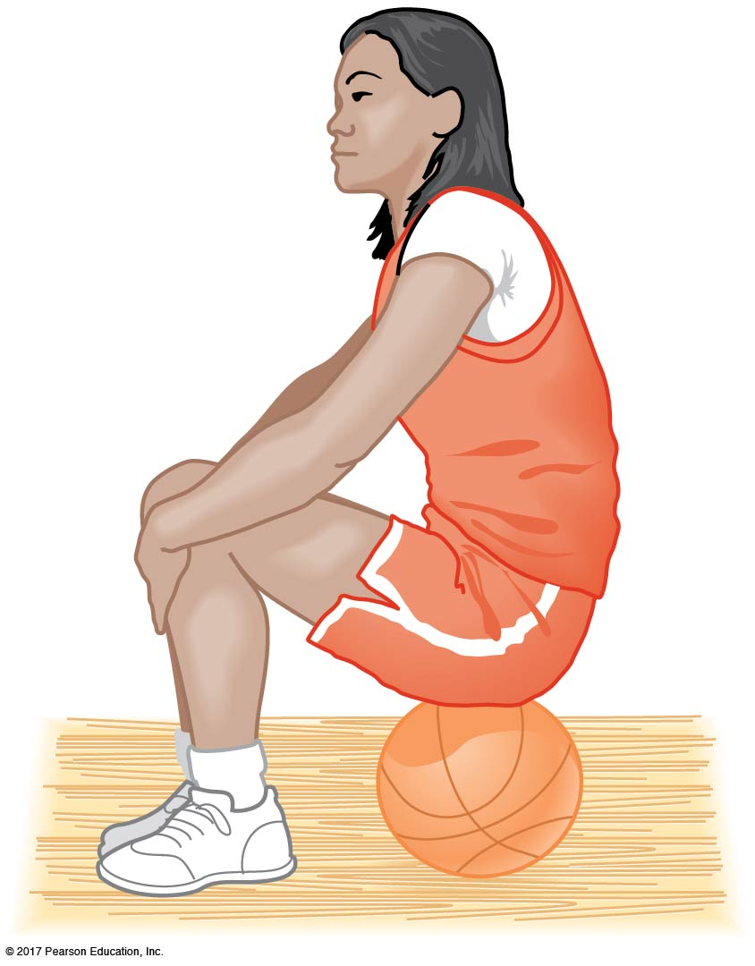
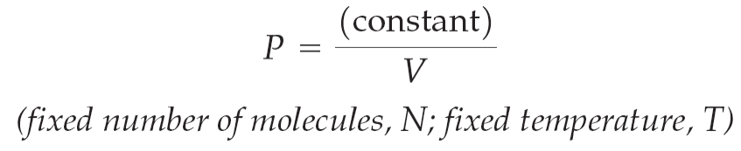
b-1 Ideal Gases
Finally, if the temperature is constant and the volume decreases, the pressure increases:

Slide 37
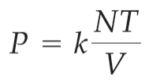
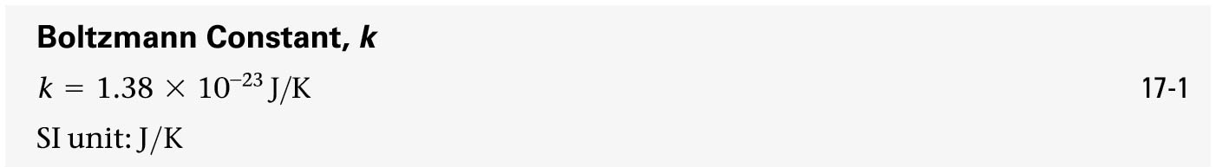
b-1 Ideal Gases
Combining all three observations, we write:
Where k is called the Boltzmann constant:

Slide 38
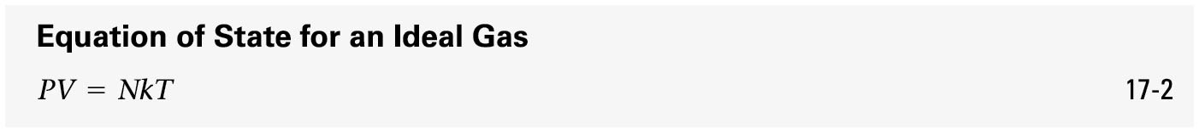
b-1 Ideal Gases
Rearranging gives us the equation of state for an ideal gas:
Instead of counting molecules, we can count moles. A mole is the amount of a substance that contains $N_{A}=6.022×{10}^{23}$ (Avogadro’s number ) molecules.
$N_{A}$ is defined to be the number of atoms in 12 g of carbon-12.

Slide 39
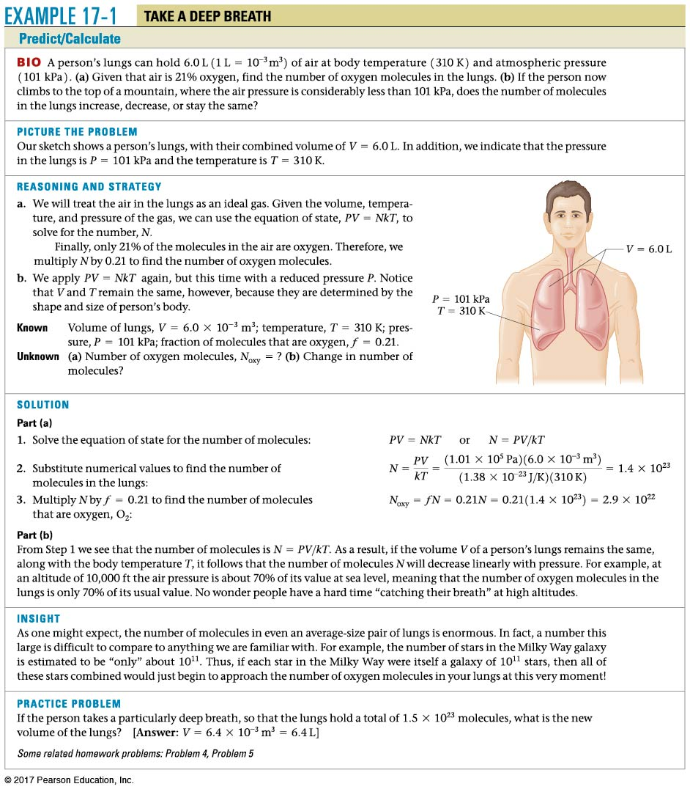
Example b.1

Slide 40

b-1 Ideal Gases
Therefore, n moles of gas will contain molecules.

Slide 41
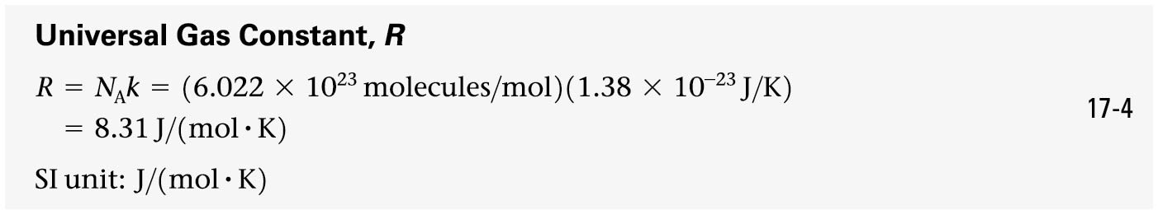
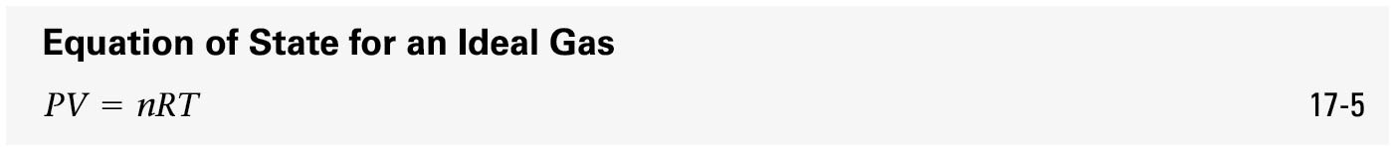
Ideal Gases equation of state
Avogadro’s number and the Boltzmann constant can be combined to form the universal gas constant and an alternative equation of state:
PV=NkT

Slide 42
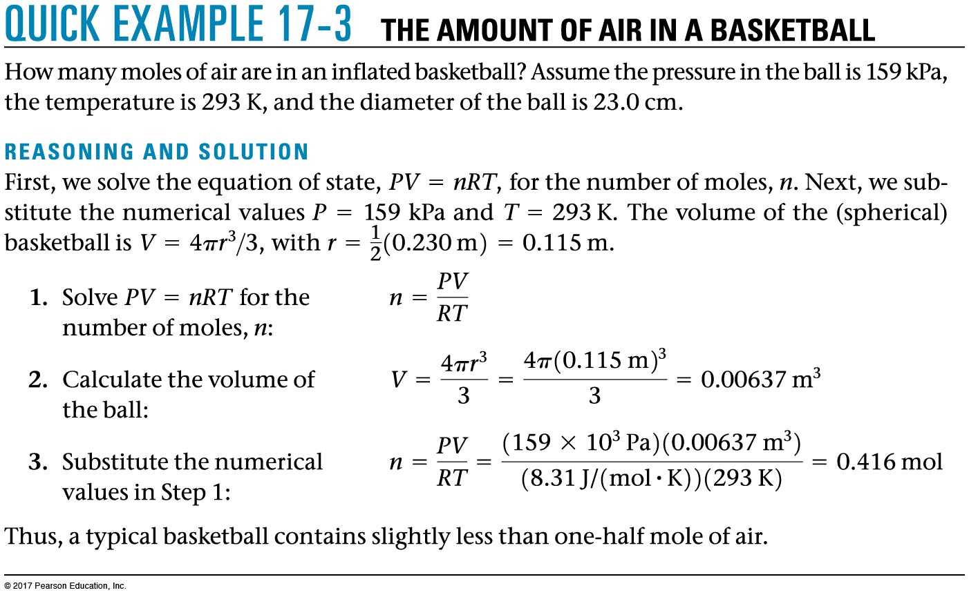
Quick Example b.3

Slide 43


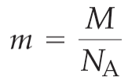
b-1 Ideal Gases
The atomic or molecular mass of a substance is the mass, in grams, of one mole of that substance. For example,
  Helium:
  Copper:
Furthermore, the mass of an individual atom is given by the atomic mass divided by Avogadro’s number:

Slide 44
Which weighs more—a mole of nitrogen (N₂) gas or a mole of oxygen (O₂) gas? [N,14, O, 16 in the periodic table]
Oxygen
Nitrogen
Both the same
Nitrogen and Oxygen
Notes:
Answer: A

Slide 45
Which weighs more—a mole of nitrogen (N₂) gas or a mole of oxygen (O₂) gas?
Oxygen
Nitrogen
Both the same
The oxygen molecules have a molecular mass of 32, and the nitrogen molecules have a molecular mass of 28.
Nitrogen and Oxygen

